Slide 1
Data Visualization - Analysis and Reporting
- By Pappu D. Kapgate

Slide 2
Agenda
BI basic,
Information gathering,
Decision making,
Managing BI,
BI User Segmentation,
Gathering BI Requirements,
Content and Knowledge Management,
Strategic Approach to BI
Significance of visual analytics
Information Visualization
Data Representation
Data collection and binding
Structured Data
Unstructured data

Slide 3
BI Basic
What is Business Intelligence
By gaining the ability to understand which datasets are relevant to particular goals, strategies, and initiatives in your organization, you’ll be able to identify trends or patterns that will help you make significant improvements in a number of key areas within the organization. This concept is known as business intelligence.
Business intelligence concepts refer to the usage of digital computing technologies in the form of data warehouses, analytics and visualization with the aim of identifying and analyzing essential business-based data to generate new, actionable corporate insights.
BI technologies offer present (real-time), historical, and predictive views of internally structured data relating to all departments within an organization, which exponentially enhances operational insight and improves the decision-making process.
Business Intelligence (BI) is a computer based technique to identified, extracting (*1) and analyzing business data. For example senior management of an industry can inspect sales revenue by products and/or departments, or by associated costs and incomes. BI technologies provide historical, current and predictive views of business operations. So, management can take some strategic or operation decision easily.

Slide 4
BI Basic
Why Are Business Intelligence Concepts And BI Solutions So Important Today?
The importance of business intelligence is growing at the same pace the data is produced – which is becoming less and less fathomable for the normal human brain.
As mentioned: We live in a world rife with digital data, and without using it to your advantage, you will quickly fall behind the pack, which will render your empire obsolete in a matter of years.
But as powerful as digital data is for decision-making and improved business efficiency, it’s only advantageous if you know how to handle it the right way. That’s where today’s BI concepts come in.
To highlight the importance of business intelligence concepts in the modern age, here are the key benefits of embracing the power of BI:
They prevent you from drowning in data
They provide a wealth of insights
Benchmarking is more accurate
You can predict your business future
They enable powerful data visualization

Slide 5
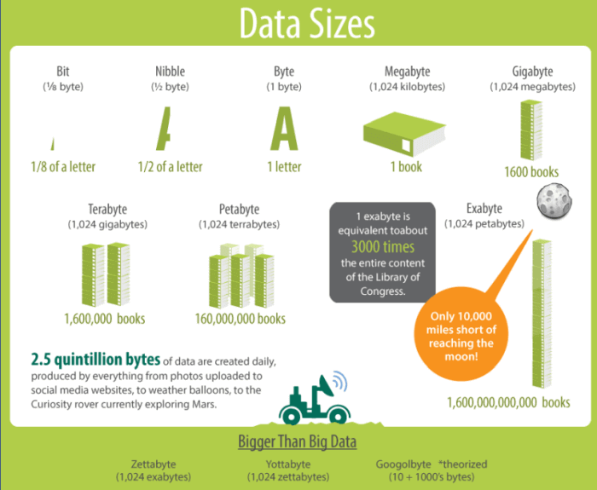
BI Basic
They prevent you from drowning in data
The fact is, without business intelligence, you risk the very real possibility of drowning in data.
Just look at these numbers:
According to CloudTweaks, in 2015 there were 2.5 quintillion bytes of data produced daily.
Do you know how much a quintillion is? It’s a 2.5 followed by 18 zeros.

Slide 6
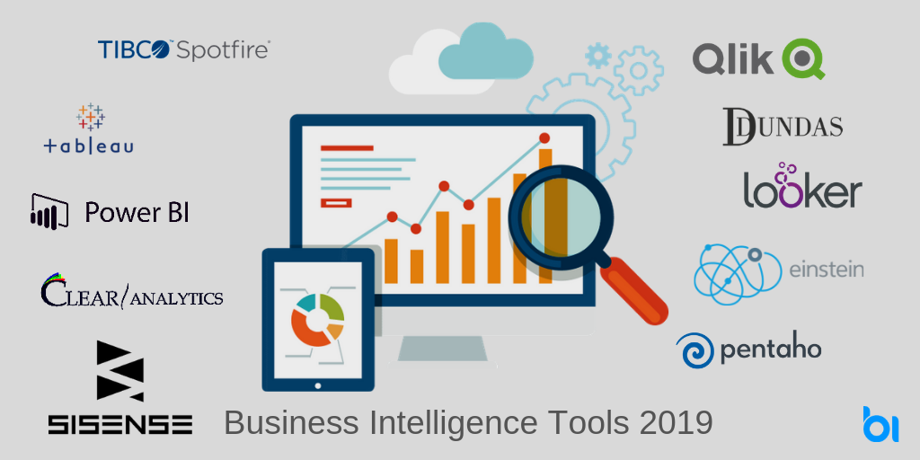
BI Basic
They provide a wealth of insights
By utilizing BI tools and concepts for your business, you’ll be able to extract a wealth of insights that will help improve;
interdepartmental and external communications,
problem-solving processes,
online data analysis,
financial efficiency,
goal-setting,
marketing, and
profitability.
Notes:
Online Data Analysis: https://www.datapine.com/data-analysis-tools

Slide 7

BI Basic
They provide a wealth of insights
By working with BI-based key performance indicators (KPIs), you’ll gain the ability to set actionable goals.
In turn, this will accelerate your overall success by helping you to formulate strategies more effectively and work towards essential benchmarks more efficiently.
By choosing and setting the right KPI template for your business, you will be able to evaluate your goals and progress on a deeper and more accurate level.
Notes:
KPI: A performance indicator or key performance indicator is a type of performance measurement. KPIs evaluate the success of an organization or of a particular activity in which it engages.
KPI Examples: https://www.datapine.com/kpi-examples-and-templates/

Slide 8

BI Basic
You can predict your business future
Another key concept of business intelligence is the ability to predict future trends.
The digestible patterns and information served up by BI tools and solutions offer a viable means of predicting future outcomes and putting plans in place to either prevent calamities from occurring or take advantage of potential trends before your competitors.

Slide 9
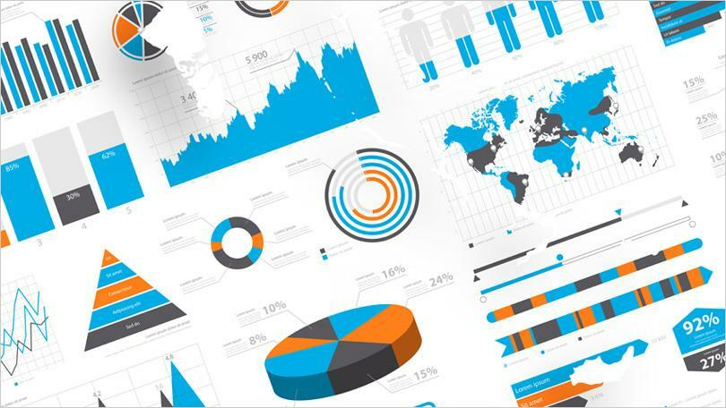
BI Basic
They enable powerful data visualization
If you’re able to visualize your data with the help of data visualization tools, making it digestible to the human eye, you’ll be able to tell a story with your insights and communicate your discoveries to others more effectively.
Doing so will boost the success of your organization, making it more powerful than ever before. And BI solutions will help you do just that.

Slide 10
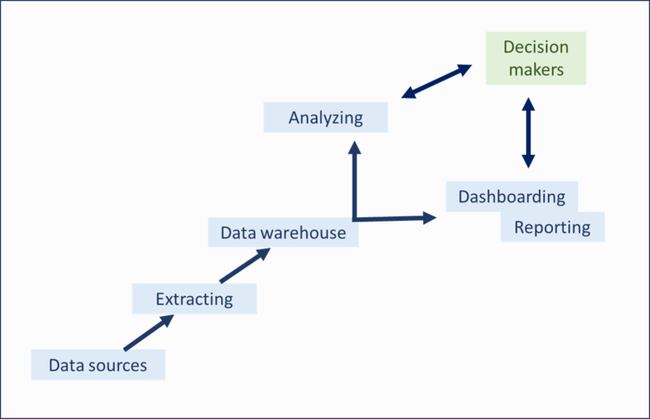
BI Basic
What Are The Concepts Of Business Intelligence?
The data itself (raw data)
The data warehouse
Data access, analytics, and presentation
Data dashboarding and reporting

Slide 11
BI Basic
The data itself (raw data)
The first component of an integral BI solution is the data itself.
This data could be anything like sales records for the year, the keywords implemented in your latest advertising program, salary and benefit tables, or profit and loss statements.
A company’s data is typically stored across a host of databases, depending on how each specific data set is collected.
As a result of this fragmentation, today’s BI solutions are developed with various data connectors that let users consolidate all of their databases into one centralized data warehouse, allowing them to work on each insight conjointly and enhancing cross-database analysis.
Notes:
Data connectors: https://www.datapine.com/data-connectors/

Slide 12
BI Basic
The data warehouse
A Data Warehousing (DW) is process for collecting and managing data from varied sources to provide meaningful business insights.
A Data warehouse is typically used to connect and analyze business data from heterogeneous sources.
The data warehouse is the core of the BI system which is built for data analysis and reporting.
Notes:
Reference for The data warehouse: https://www.guru99.com/data-warehousing.html

Slide 13
BI Basic
Data access, analytics, and presentation
Once all of your data is connected and can ‘talk to each other,’ one of the next key business intelligence concepts is to make use of that data.
This involves accessing the data, analyzing it for important trends, and presenting it in a way that is immediately understandable.
These steps can often blend together, especially if you use interactive dashboards that let you zoom in and out of your data according to your business need.
Data presentation has also come a long way since the Excel days.
Now there are beautiful, intuitive dashboard examples that can give you the information you need at a glance.
Notes:
Reference for The data warehouse: https://www.guru99.com/data-warehousing.html

Slide 14
BI Basic
Data dashboarding and reporting
Building on our previous point, the fourth and perhaps most pivotal component of an interactive dashboard is the ability to continuously track, monitor, and report your data.
By having access to a flexible, customizable, data-driven dashboard, you can to set targets, identify patterns, spot trends, and uncover insights that foster growth and improvement.
Though initiative functionality and seamless data visualization, it’s also possible to share your discoveries with others within the organization in a way that's inclusive as well as digestible.
Moreover, today’s BI-based dashboard reporting is portable, meaning that it’s possible to log in, analyze data, and share information wherever you may be in the world, 24/7, on a multitude of devices.
It’s clear that these 4 concepts of business intelligence are a recipe for data-driven success.

Slide 15
Information Gathering
What is Information Gathering?
Data collection is an extensive process of collecting information to make direct observations and answer open ended questions.
Businesses use data gathering to gain real-time insights into a particular issue or workflow process.
The research performed through data collection and analysis allows stakeholders to make more informed decisions that improve the company's overall performance.
A team will also need to research which data sources are most useful to answer research questions regarding different areas of the business.

Slide 16
Information Gathering
What is Information Gathering?
Organizations collect their data through several different research methods including-
Website(s)
Interviews focus groups
Case studies
Transactional history
Interview questions
Contests or giveaways
Online surveys/questionnaires
Online user profile information
Event sign-up information
Social media activity

Slide 17
Decision Making
What is Decision Making?
Simply put, decision-making is the process of deciding something, especially with a group of people.
From a business decisions perspective, the aim is to achieve business objectives to satisfy stakeholder needs and expectations.
For the decision to be effective, however, decision-makers must forecast the outcome of each option and determine which is best for a particular situation.
That makes decision support systems (DSS) like decision intelligence and business intelligence absolute essentials.

Slide 18
Decision Making
Business intelligence decisions
Business intelligence decisions typically fall into three categories:
Strategic
tactical, and
operational.
An organization needs to gain a complete understanding of these types of decisions in business intelligence to make better-informed decisions that lead to increased customer and stakeholder satisfaction, operational efficiency, and revenue.

Slide 19
Decision Making
Business intelligence decisions
Strategic decisions:
Strategic decisions comprise the highest level of organizational business decisions, are usually infrequent and made by the organization’s executives.
Yet, their impact is enormous and far-reaching.
Some types of strategic decisions include selecting a particular market to penetrate, a company to acquire, or whether to hire additional staff.
Decisions made at this level usually involve significant expenditure. However, they are generally non-repetitive in nature and are taken only after careful analysis and evaluation of many alternatives.

Slide 20
Decision Making
Business intelligence decisions
Tactical decisions:
Tactical decisions occur with greater frequency (e.g., weekly or monthly) and fall into the mid-management level. Often, they relate to the implementation of strategic decisions.
Examples of tactical decisions include product price changes, work schedules, departmental reorganization, and similar activities.
The impact of these types of decisions is medium regarding risk to the organization and impact on profitability.

Slide 21
Decision Making
Business intelligence decisions
Operational decisions:
Operational decisions usually happen frequently (e.g., daily or hourly), relate to day-to-day op­erations of the enterprise, and have a lesser impact on the organization.
Operational decisions determine the day-to-day profitability of the business, how effectively it retains customers, or how well it manages risk.
Answering a sales inquiry, approving a quotation, or calculating employee bonuses may be examples of this decision type.

Slide 22
Decision Making
Business intelligence decisions
You can summarize these types of decisions in business intelligence this way:
Strategic – Long-term, complex, made by senior managers;
Tactical – Medium-term, less complex, made by mid-level managers;
Operational – Day-to-day, simple, routine, made by junior managers.

Slide 23
BI Management
What is BI Management and What does include?
BI Management refers to the process of data management.
It generally is composed of four components:
analysts,
data solutions,
decision making, and
oversight.
BI software generates the actual data and then BI management interprets the data using tools in the BI systems.
The raw data is analyzed and converted into performance metrics that business users rely on to make decisions.

Slide 24
BI Management
Analysts
BI management requires analysts who specialize in data preparation.
These analysts break down the data, review statistical evidence, validate data quality, and solve quantifiable problems, issues and concerns.
Analysts are responsible for all data-driven numbers within the framework of an organization or project.
These analysts generate the reports using BI software that contain crucial BI strategy information like KPIs or other business data needed to make decisions.

Slide 25
BI Management
Solutions
Analysts provide data solutions related to business strategies.
Ultimately, data doesn’t lie – as long as it’s sound. Assuming you have good data, BI management can dive deep into that information as it relates to the company’s overall strategy, growth or particular project.
It can include data such as customer statistics, sales figures, business performance, production benchmarks, supply chain operation and much more.
Companies, sports teams, and other entities are making massive big data pushes.
Predictive analytics is game changer for all and with new technology, data warehousing is easier than ever.
With a plethora of data at our fingertips, self service BI software available to us, our decisions and solutions for all things is reliant upon data.

Slide 26
BI Management
Better Decision-Making
Decision makers use the data analysis in forms of KPIs to improve business processes and increase profitability.
Keep in mind that business intelligence is not only about mining internal data. Smart BI pulls from external data sources, as well.
Finding and parsing data from external sources in the marketplace and your competitors can be just as important as internal data mining.
Remember, when data mining from external data sources, it’s important to check the data quality as well.
Using bad data will hurt your business when making business performance decisions.

Slide 27
BI User Segmentation
What is BI User Segmentation?
User segmentation is the practice of bucketing users into groups based on common characteristics (e.g., region, age, device, or behavior).
Segmentation allows for better targeting based on user traits or behaviors so that each segment can be treated with a more customer-centric approach.
User segmentation is the process of separating users into distinct groups, or segments, based on shared characteristics.

Slide 28
BI User Segmentation
Why do we want to segment our users?
The main reason we want to segment our users is to get a better understanding of our user base.
Not all users are created equal and it's important to understand how different segments of users perform.
Let's take an example to explore this concept in more detail. Let's say that we've built a service which is specifically designed for freelancers. Since we want to make it easy for freelancers to sign up to our service, we provide the service for free for the first 30 days.
When we analyze our accounts we see that on average only 10% end up converting to a paying account.
This is what I like to call the "fully blended" view of a metric.
When you don't segment your users and group everyone together, this is a fully blended representation.
Now let's say we segment our users by the number of years they have worked as a freelancer.

Slide 29
BI User Segmentation
Why do we want to segment our users?
When we do that we see the following:
0 - 1 year: 2% conversion to paid
1 - 3 years: 15% conversion to paid
>3 years: 20% conversion to paid
Since there is a big difference between someone who is just starting as a freelancer compared to someone who has been doing it for a while, we see a big difference in adoption for our service.
A freelancer who is just starting has limited resources and is less likely to invest in software than a freelancer with a successful business.
If we just looked at the "fully blended" view we would miss out on this important insight.
We can now take this insight and use it to make strategic decisions that will impact all areas of the business.

Slide 30
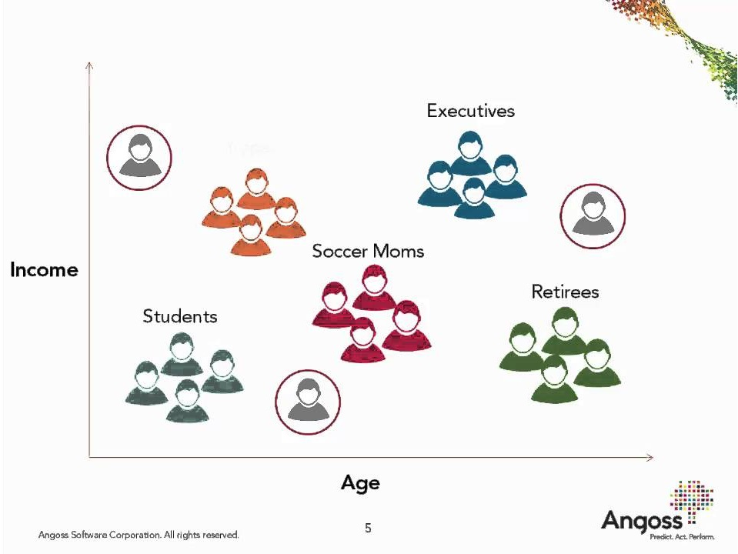
BI User Segmentation
Why do we want to segment our users?

Slide 31
BI Requirement Gathering
Defining requirements for business intelligence projects is critical.
Most BI projects fail because of poor requirement gathering.
If your BI Project cannot fulfill the reporting requirements of your end users, then all your efforts will go in vain.
You should gather business intelligence reporting requirements comprehensively to make your BI project a success.

Slide 32
BI Requirement Gathering
How To Gather Business Intelligence Reporting Requirements?
The best way to capture business intelligence reporting requirements, is by asking the right questions.
Here are the main questions you need to ask when you embark upon collecting BI reporting requirements.
Who is your target audience?
What are the business questions/problems to be solved?
Identify KPIs & Metrics
Create a List of Deliverables
Identify Data sources

Slide 33
BI Requirement Gathering
Who is your target audience?
Every business intelligence project is meant to satisfy a set of end users. So find out who all will access your BI project, as well as your business intelligence reports.
You will find that a single BI project is used by multiple departments as well as functional roles. Make a list of all users for your BI project.
Reports & Dashboards are the final outputs of every business intelligence system.
Find out who will need a BI project deliverable such as reports, graphs, dashboards, presentations, etc. End users such as senior management and department heads will need you to give them a report.
So now you know for whom you need to create BI deliverables.

Slide 34
BI Requirement Gathering
What are the business questions/problems to be solved?
Next, ask your target users as to what business questions they are trying to answer, or solve. Find out
Why can’t they be answered at the moment?
What are the deficiencies with the existing tools & system?
What are the problems with their existing data sources?

Slide 35
BI Requirement Gathering
Identify KPIs & Metrics
Once you have identified the business problems troubling your target users, and the deficiencies in your current system, it’s time to quantify them.
Ask your target users the following questions to understand if they are already receiving any deliverables, and how they can be improved.
What reports do they use at present, if any? Is there a way to build better dashboards & reports?
What is the frequency and format of these deliverables?
How do they access reports? How to they use this information?
Are there any third-party reporting tools and people involved presently? Get their details.
Which KPIs & metrics do they track to do their job better? At what intervals?
What additional metrics do they want to track, that are absent in their present reports?

Slide 36
BI Requirement Gathering
Identify KPIs & Metrics
If they are already using a report, then make sure your new report contains most of its KPIs.
This will lead to a smoother transition.
Also, keep in mind that any change in report frequency, report format and report access methods, will require fresh training and communication.
So it is advisable to design dashboards & reports that have a similar format, frequency and access methods, as the old ones, unless your business has decided to take a different route altogether.

Slide 37
BI Requirement Gathering
Create a List of Deliverables
Create a simple spreadsheet which lists all the types of business intelligence reports your BI Project needs to deliver.
For each report, mention
Report Title & Description
Target Users
Report Format – CSV files, Spreadsheets, Web reports, PDF, Presentations, etc
Report Frequency – daily/weekly/monthly/quarterly.
Also mention on which day the reports need to go out
Metrics & KPIs to be measured. Data Visualization to be used for each metric.
When you make this list, you’ll find that some reports share many metrics & KPIs, and can be merged into a single report. Similarly, you’ll find that different target users require similar reports, with minor difference.
Consolidate such reports after discussing with the appropriate stakeholders.
This is one of the key steps in gathering business intelligence reporting requirements.

Slide 38
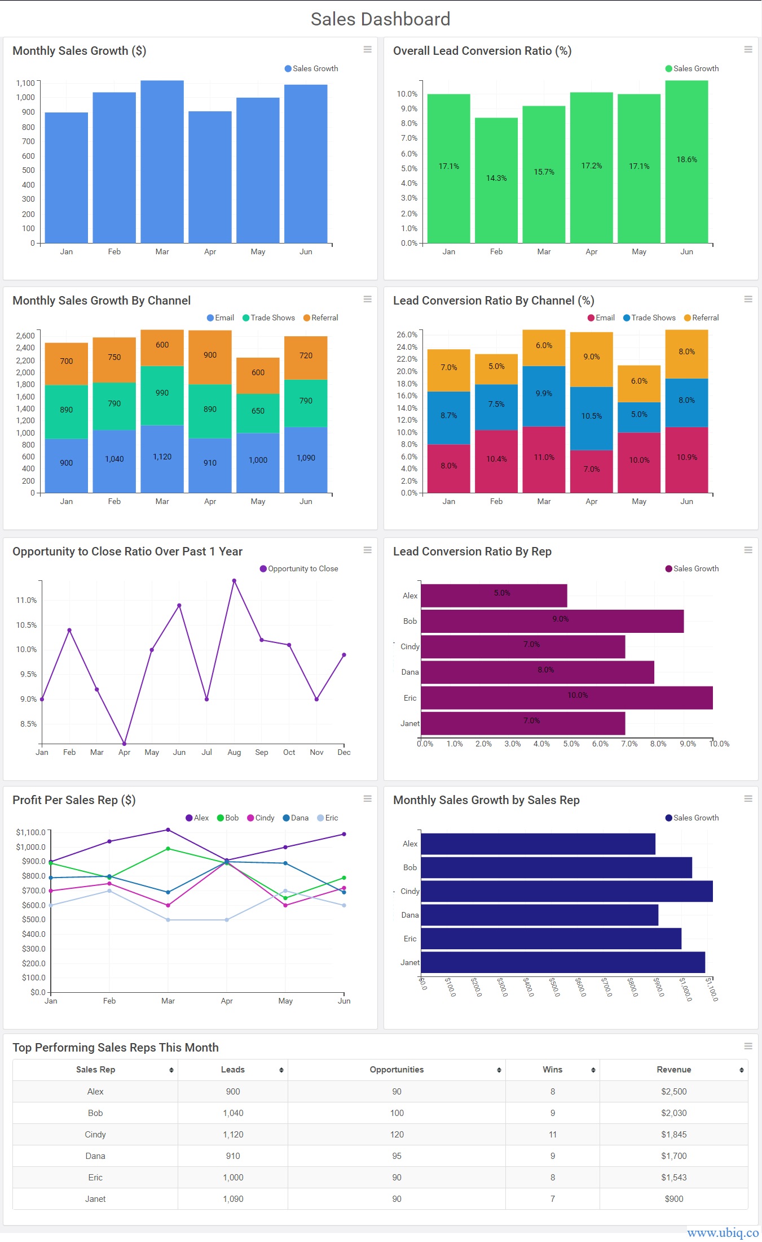
BI Requirement Gathering
Create a List of Deliverables

Slide 39
BI Requirement Gathering
Identify Data sources
Each report works on a set of data sources. Find out how to calculate each KPI & metric.
This will tell you which data sources are required for each KPI. For each KPI, list input data fields required and calculation steps.
Find out which data sources are presently available in-house, which ones are third-party data. Also, determine if you need ask for additional data.
If so, whom to approach in this regard. What is the cost of getting additional data? Document these as a BI reporting requirements template and share them with your team.
Once you have a clear idea about all the target users, list of deliverables and list of data sources. Only then you will be in a good position to come up with intuitive business intelligence reports that fulfill all the business intelligence reporting requirements of your target audience.
Needless to say, gathering business intelligence reporting requirements is an iterative process and involves some trade-off between value and feasibility, that varies from organization to organization.

Slide 40
Strategic Approach to BI
A business intelligence strategy is your Blueprint for deciding how you will use data in your company.
You need a strategy because merely choosing the right technology, and implementing a software platform is not enough to realize a return on investment. To create a strategy, you must determine three things.
How will you deploy the software platform?
How will you manage the data for analysis?
And how will you enable your people to make informed, data-driven decisions?
A business intelligence strategy will help your company reap the rewards of having actionable insights.
Examples include access to sales performance benchmarks, human resources salary forecasts, and ensuring your shipping department knows what to ship each day.
Success occurs from systematically approaching the project with a defined BI strategy, including discovery, planning, and measured execution.

Slide 41
Strategic Approach to BI
Steps to Create a BI Strategy
Your BI strategy needs to first align with your business goals and vision.
With business intelligence, data can drive transformation in your organization. This initiative will place trusted, relevant data in the hands of employees so they can make informed decisions every day.
You can start this transformation now by following our Blueprint.
Choose a sponsor
Choose your BI platform
Identify the key stakeholders and get them involved
Assemble your BI team
Define the scope of BI
Prepare your data infrastructure
Develop a business intelligence roadmap

Slide 42
Strategic Approach to BI
Choose a sponsor
Ideally, your choice to sponsor the project and get buy-in from other high-level employees should be an executive-level leader.
Before you begin, you need participation and alignment on the vision of BI in the company. Organizations who value data in every department appoint a Chief Data Officer to sponsor the BI initiative.
The CDO or other executive sponsor needs to consider the support and training required for deployment and consider how to scale this platform to the entire enterprise.
Keep your sponsor up to date on your progress. When you have launched your BI platform, and it’s working as expected, generate some valuable, visible reports to share with your sponsor.
Prove to your sponsor, and therefore the company, that your strategy is working.

Slide 43
Strategic Approach to BI
Identify the key stakeholders and get them involved
Business intelligence may include software, but that doesn’t mean it’s only an IT project.
BI also requires financial data, but that doesn’t mean it’s only the finance department’s concern.
You should bring in a representative from every team affected by your BI plan.
Get them involved early and interview them. Ask them
how they use data in their work,
what is working for them, and
what isn’t working for them.
Use those insights to tailor your BI scope.

Slide 44
Strategic Approach to BI
Assemble your BI team
Your BI team will be responsible for implementing your strategy. You can hire new people or have people fulfill multiple functions if your organization is small.
BI platforms ensure that reports and dashboards are accessible and approachable to non-analysts (known as self-service business intelligence).
However, to get the platform up and running correctly, you will need this cross-functional team to implement the BI plan. These are some of the roles and responsibilities for the BI project team:
An IT service owner or analytics director to manage the software platform
An enterprise architect who integrates the platform with the existing data architecture
A site administrator to organize the content, and create user groups and permissions
A data steward to put the data in context and document processes and procedures for using the platform
But these aren’t all the people involved in the project. You will also need a steering committee and executive sponsor to ensure the project is meeting its deadlines.

Slide 45
Strategic Approach to BI
Define the scope of BI
Before you deploy business intelligence software, you need to decide what BI means to your organization.
Business intelligence means using data to make business decisions.
But you need to determine how that will work in the day-to-day operations of your company and which departments will use BI.
For example, Coca-Cola created customized dashboards for customer service specialists.
Chipotle created a unified view of their restaurant locations to compare performance between them.
HelloFresh created automated reporting of campaign results, saving hundreds of hours of analysis time.
There are many examples of companies using business intelligence in innovative ways.
Decide how you want to integrate BI to support your company objectives. After you define your operational definition of business intelligence, you should decide which divisions of your company to include first.

Slide 46
Strategic Approach to BI
Define the scope of BI
Are you using business intelligence to understand and predict financial performance, human resources, supply chain, or inventory changes? Will you be analyzing a combination of these or something else entirely?
The scope of analysis within the business needs to be clear before you move on to the next steps. Once the scope of analysis is clear, you need to choose what you want to measure within that data. Identify which metrics and reports would be the highest priority for your company’s leadership.
These reports should include your key performance indicators (KPIs) that align with overall company goals to measure success. These can be internal metrics compared to past performance benchmarks, as well as external metrics.
What KPIs indicate success in your industry? Competitive analysis is becoming a crucial part of business intelligence. BI tools are allowing organizations to monitor competitors’ performance, changes in the market, and customer behavior changes.
You can do this by analyzing competitors’ case studies, blogs, articles, videos, etc. After defining your scope of business intelligence, you will probably realize just how big of a project it will be to implement BI. Now you must identify your people resources to implement your strategy.

Slide 47
Strategic Approach to BI
Prepare your data infrastructure
Business intelligence must have clear data sources to perform an accurate analysis.
Traditionally, BI platforms import data from a data warehouse. With modern BI, you can analyze data from multiple sources. We differentiate between two types of data: trusted and untrusted.
Trusted data is stored in databases or easily imported into databases such as spreadsheets, customer relationship management (CRM) data, financial data, etc. This is the data you probably have used in previous business analytics.
Untrusted data is information such as emails, conversations with customers, business processes, images, news items, trade journals, etc. With modern BI, you can bring untrusted data into a governed and secure environment for analysis.
The BI team needs to survey stakeholders and information consumers to see what data sources they will need for analysis before deploying the BI platform.

Slide 48
Strategic Approach to BI
Develop a business intelligence roadmap
The BI team should develop a roadmap for the implementation of your strategy. Here are things you should consider when creating a BI roadmap:
Keep track of milestones and dependencies such as when your data warehouse will be ready
Keep your eye on the future and adapt your roadmap when needed
Be proactive, not reactive
Decide when your platform will launch and when your data warehouse will be ready for your BI initiative. Be prepared to adapt your BI roadmap when needed.
Business intelligence is beneficial when it’s proactive. If your BI strategy focuses on reacting to ad hoc reporting requests, you won’t use business intelligence to its full potential.
Mark on your roadmap when new events happen such as new business, new initiatives, changes in the market, or changes in customer behavior.
Notes:
Ad hoc reporting is a business intelligence process used to quickly create reports on an as-needed basis. Ad hoc reports are generally created for one-time use to find the answer to a specific business question, such as how many support tickets were resolved last week or how many calls a salesperson made yesterday
What is the meaning of ad hoc in business?
The definition of “ad hoc” is on the spot, or done for a particular purpose as necessary. In BI, the process of ad hoc analysis is to answer one specific business question. This type of analysis may be done in response to an event, like a decrease in sales.

Slide 49
Significance of visual analytics
Why visual analytics?
Discover the unexpected; it’s all about the journey.
Sounds like the beginning of a travel brochure, right?
Well, it fits because visual analytics helps you navigate a world full of data.
When you are trying to make sense out of your data, where do you begin?
Two popular approaches to visual data analysis include data visualization and visual analytics.
Each plays an important role in data exploration. You don’t have to choose one or the other— they both help you to see and understand your data.
Data exploration usually starts with a question. But the answer to that question doesn’t need to be the end of the journey

Slide 50
Significance of visual analytics
Asking “what” and “why”
A data visualization is a graphical depiction of data, such as dashboard or report. Data visualizations present views of data that answer “what,” such as, “What are our sales and profits, for different regions, and different months or years?”
They are good for answering a finite set of questions, and can be static or provide some level of interactivity for investigating those questions.
Being able to answer “what” questions in your data is incredibly valuable. It helps to tell a story about your data, and to identify problems and issues.

Slide 51
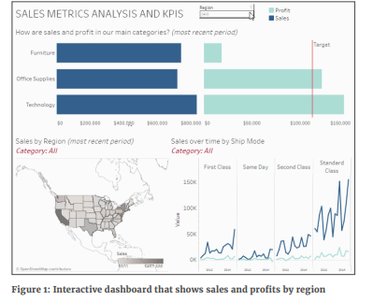
Significance of visual analytics
Asking “what” and “why”
For many people, creating dashboards and reports are the goal and final destination of their data exploration.
But what if the data is revealing some type of issue, such as lower profits for a certain region or type of product?
To get to the root cause of an issue or problem, you need to be able to explore the dashboard’s data directly, beyond the limits of a canned set of filters and categories.
You might need to view the data with new types of visualizations, beyond the constraints of report templates and canned chart types, to answer your own questions.

Slide 52
Significance of visual analytics
The power of asking why
Answering “what” is the first step in exploring data. The next step is asking “why.” To dig deeper, you need to be able to ask why and why again.
When you need to learn more about what the data is telling you, you need visual analytics.
Visual analytics is a dynamic, iterative process where you quickly build different views to explore infinite paths of “whats,” and the “whys” behind them.
Visual analytics can help you explore, find answers, and build stories in your data.
It even goes beyond those initial insights, so everyone who sees the visualization can ask questions and make unexpected discoveries.

Slide 53
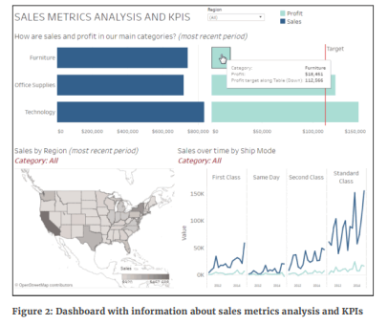
Significance of visual analytics
Asking “what” and “why”
An example of visual analytics in practice The following example walks through a typical visual analytics workflow.
Let’s go back to the interactive sales report dashboard. It is a data visualization that answers a set of questions about sales and profits, for different regions.
Furniture is not hitting the profit target, but looking at different regions isn’t showing me why.
To explore why, I want to create a new view that shows sales and profits for each type of product included in Furniture.

Slide 54
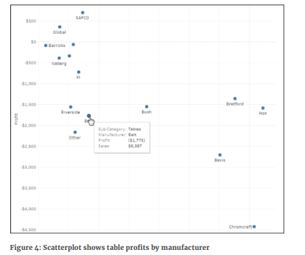
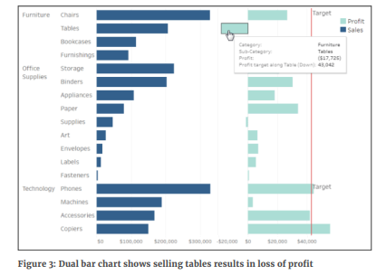
Significance of visual analytics
Asking “what” and “why”
Now I see that tables are not profitable. To answer why, I’ll look at sales and profits for table manufacturers only.

Slide 55
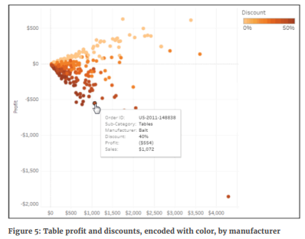
Significance of visual analytics
Asking “what” and “why”
Why are so many different brands of tables losing money? We often apply discounts to tables. I’m going to change the view to see what level of discounts have been applied to every table sale order.
It looks like selling tables at a discount is creating lost profits. I’ve found the root cause of our issue. Being able to ask why and quickly see the answer in my data revealed the underlying cause (discounting strategy) to the original problem (lack of profit in furniture).
Now what if I told you that I was able to create all of the views for that exploration in under 10 minutes? That is pretty fast.
Think about the time a tool like this can save you in your daily work. That is the power of visual analytics.
Notes:
For more Reading
https://www.tableau.com/sites/default/files/whitepapers/752750_core_why_visual_analytics_whitepaper_0.pdf

Slide 56
Information Visualization
What is Information Visualization?
Information visualization is the process of representing data in a visual and meaningful way so that a user can better understand it.
Dashboards and scatter plots are common examples of information visualization. Via its depicting an overview and showing relevant connections, information visualization allows users to draw insights from abstract data in an efficient and effective manner.
Information visualization plays an important role in making data digestible and turning raw information into actionable insights.
It draws from the fields of human-computer interaction, visual design, computer science, and cognitive science, among others.
Examples include world map-style representations, line graphs, and 3-D virtual building or town plan designs.
The process of creating information visualization typically starts with understanding the information needs of the target user group.

Slide 57
Information Visualization
What is Information Visualization?
Qualitative research (e.g., user interviews) can reveal how, when, and where the visualization will be used.
Taking these insights, a designer can determine which form of data organization is needed for achieving the users’ goals. Once information is organized in a way that helps users understand it better—and helps them apply it so as to reach their goals—visualization techniques are the next tools a designer brings out to use.
Visual elements (e.g., maps and graphs) are created, along with appropriate labels, and visual parameters such as color, contrast, distance, and size are used to create an appropriate visual hierarchy and a visual path through the information.
Information visualization is becoming increasingly interactive, especially when used in a website or application.
Being interactive allows for manipulation of the visualization by users, making it highly effective in catering to their needs. With interactive information visualization, users are able to view topics from different perspectives, and manipulate their visualizations of these until they reach the desired insights.
This is especially useful if users require an explorative experience.

Slide 58

Information Visualization
An Example of Information Visualization
The image portrays the frequency of lung cancer within the United States by geographic region.
Mapping disease data like this enables researchers to explore the relationship between a disease and geography.
It’s important to note that this data doesn’t explain why there is a spike in cancer rates in the South East of the United States but it does indicate that there is a spike which is worthy of further investigation.
Explorative analysis through information visualization allows you to see where relationships in data may exist.

Slide 59
Information Visualization
The Take Away
Information visualization is designed to help us make sense out of data.
It can be used to explore relationships between data, to confirm ideas we hold about data or to explain data in easy to digest manner.
It may also be used, rightly or wrongly, to help persuade someone with data.
As the volume of data available to us increases exponentially in every field of endeavor – information visualization is becoming increasingly important as a skill in the workplace and in academia.

Slide 60
Data Representation
With the basic understanding of Business Intelligence, we should know the importance of data presentation in information delivery and how useful it is for business users.
After storing data in the required form, either in a data warehouse/data mart database or an OLAP cube, data can be showcased in certain forms that will become the source of required information for all BI users; this is known as Reports in the BI world.
These Reports can be data reports, executive dashboards, or conference presentations.
There is a wide selection of data visualization software from which to choose. Each tool has a peculiar set of data visualization features. All of them are unique in their combination, making them suitable for diverse business needs. They are:
Power BI
Tableau
Looker
Exago

Slide 61
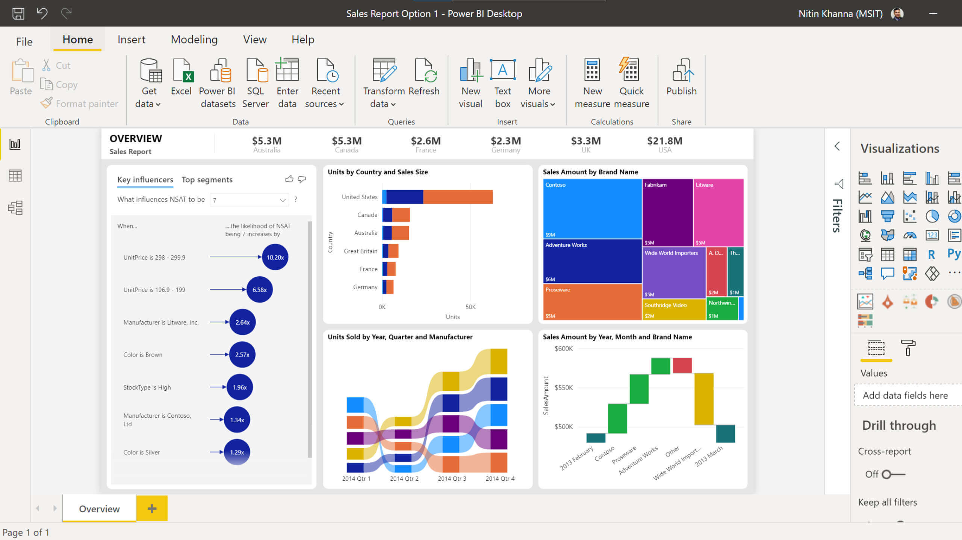
Data Representation
Power BI
A comprehensive analytics platform for data processing, Microsoft Power BI enables businesses to retrieve essential sets of data and convert them into comprehensive and visually appealing materials.
It can be powered by machine learning algorithms to perform predictive analytics, and allows users to monitor the dynamic flow of business data, from both desktop and mobile devices, making its functionality particularly convenient.
Power BI is equally applicable for medium and large businesses. Integration is available for Microsoft Excel, Microsoft Dynamics, Salesforce, and Google Analytics.
Notes:
For example, our HR department has all-in-one stats, charts, and maps combined with advanced analytics on employee retention. They can also quickly pull up an employee count according to a wide variety of criteria, e.g., segmented headcount, technology stack, project assignments, geographical data, age, satisfaction reviews, etc., in order to manage resource capacity, turnover, and KPIs.

Slide 62
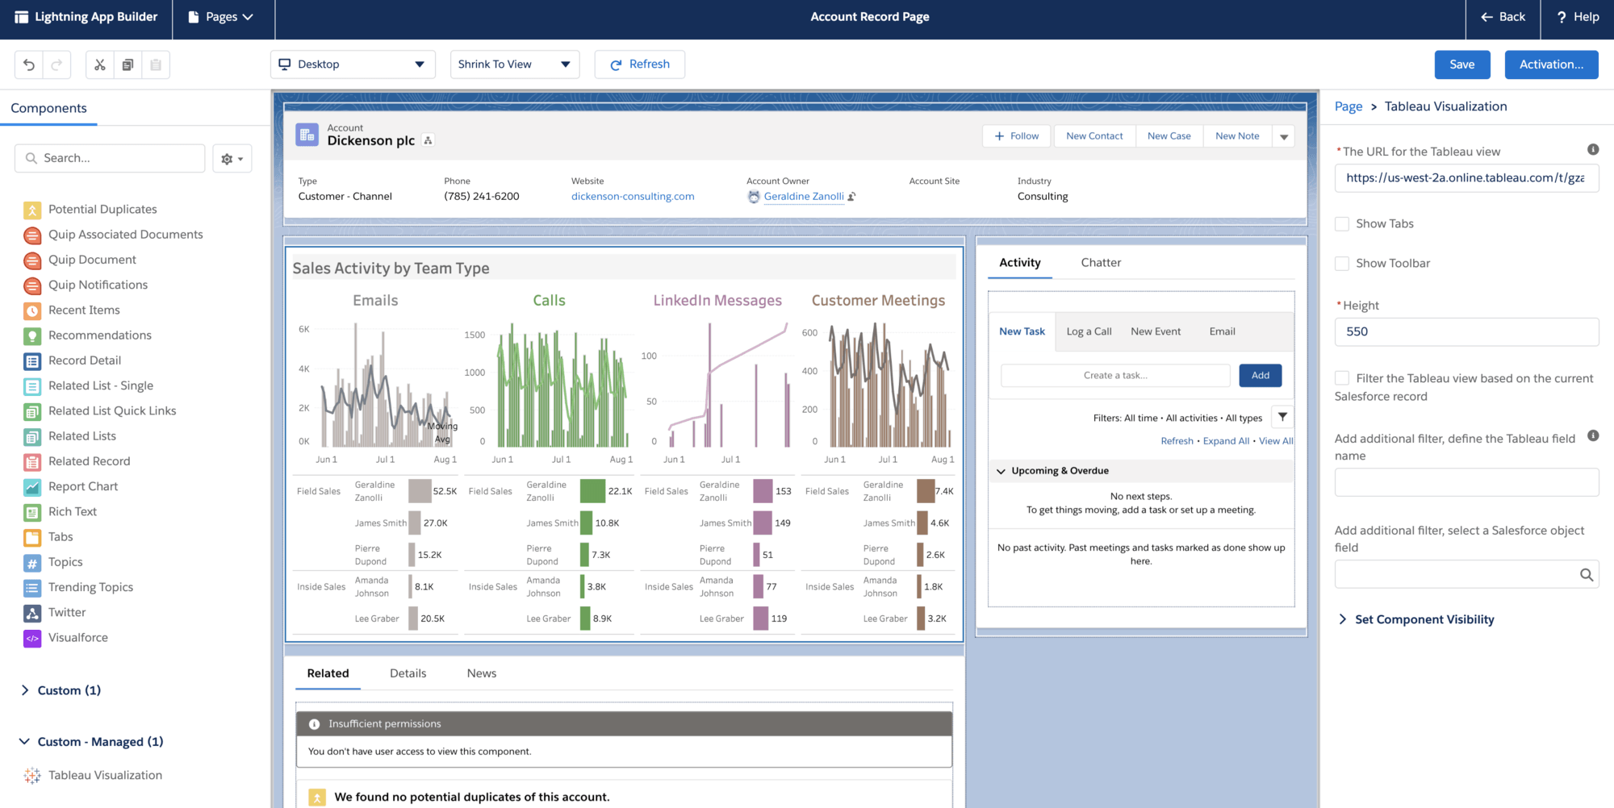
Data Representation
Tableau
Tableau is probably one of the best data visualization tools, as it provides remarkable data analytics for enterprises, and is praised for being able to create reports with massive amounts of data from multiple sources while maintaining optimal network performance at the same time.
This incredibly user-friendly software supports a wide scope of integrations, including, but not limited to Slack, Hadoop, R machine learning packages,Targetprocess, BIM 360, Workable, Smartsheet, Greenhouse, Lever, Clarizen, bpm’online, etc.

Slide 63
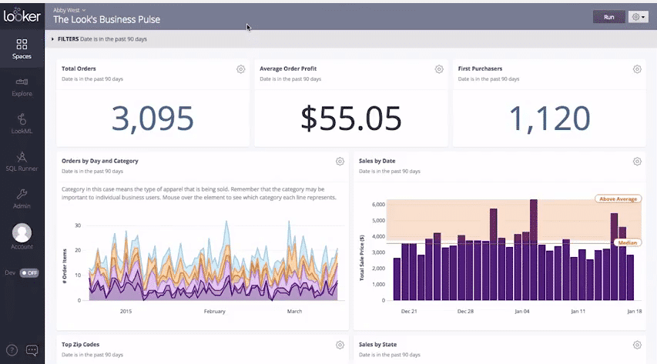
Data Representation
Looker
This platform enables business owners to make more knowledgeable decisions by retrieving real-time interactive data.
This is a well-structured and convenient cloud-based software that does not require desktop installation.
Due to a wide range of features, the software analyzes data throughout the entire database. Looker uses GIT, hence all the changes made to the modeling layer are being tracked. This functionality allows several developers to work on it simultaneously with the highest data quality. Likewise, it generates SQL based on the designed semantic level. All information retrieved by the software is shown to the user in graphs or tables, which makes it possible to work directly with the full dataset.

Slide 64
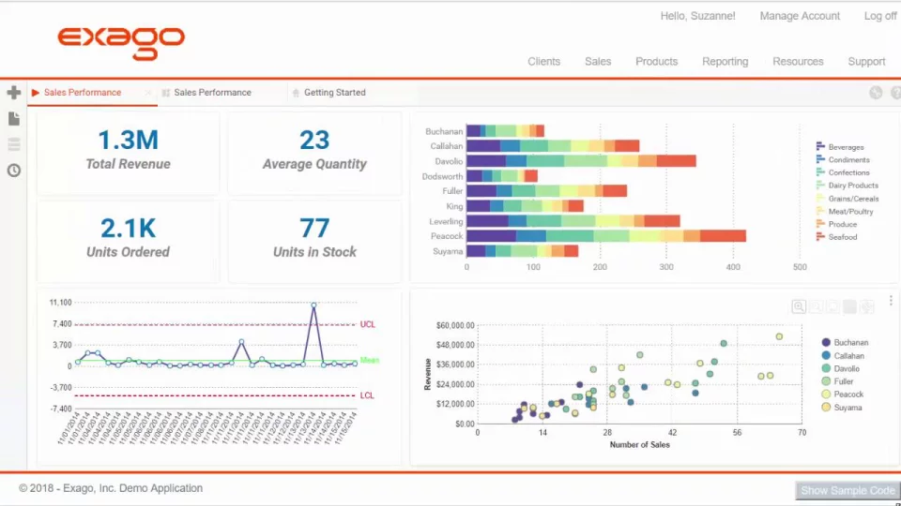
Data Representation
Exago
Exago is a fully web-based embedded business intelligence software and an incredibly potent application that provides integration via API.
The software can be especially useful for enterprises that are interested in providing business data for a specific purpose and comprehensive analytical reporting to their clients.
Exago is a perfect match for businesses of any size. Its performance is generally very good, yet, like any other web-based tool, it depends upon the characteristics of the server.
Some of Exago’s major characteristics are its user-friendliness and highly customizable settings.

Slide 65
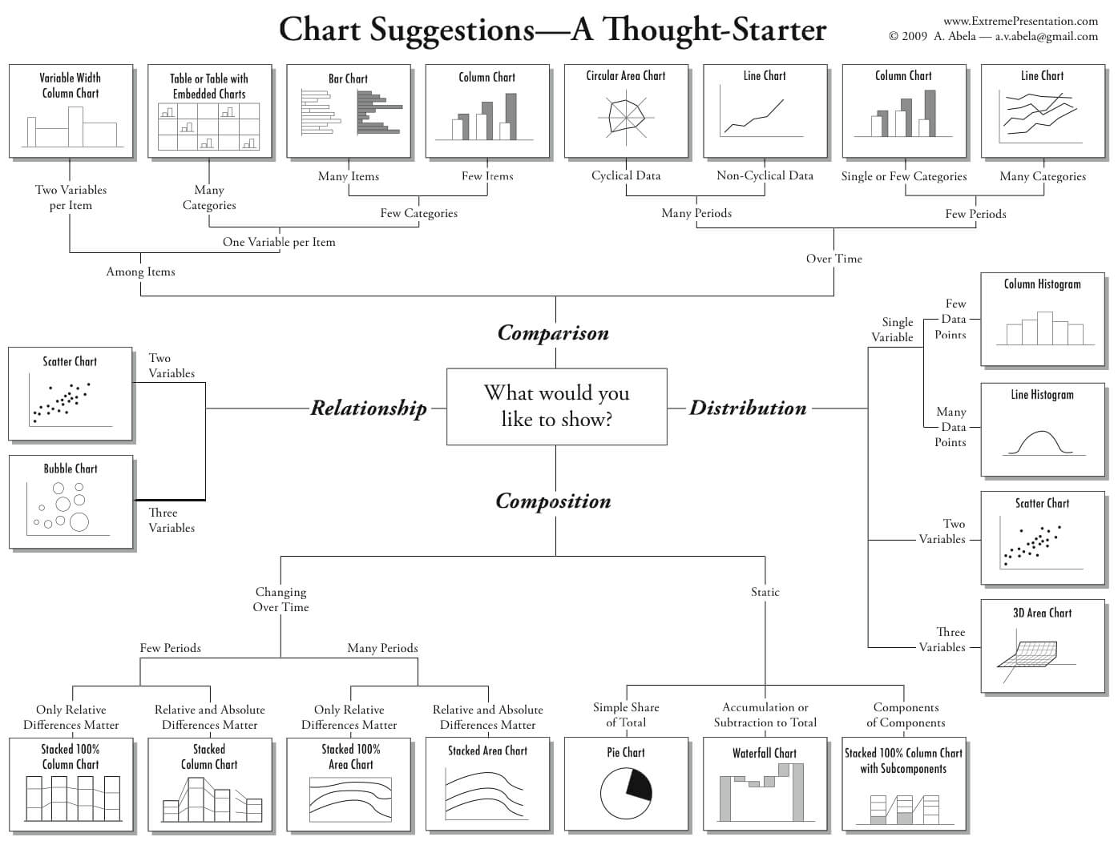
Data Representation
Data Representation Chart in Power BI
Notes:
https://www.tableau.com/sites/default/files/whitepapers/which_chart_or_graph_is_right_for_youwp_1.pdf
https://docs.microsoft.com/en-us/power-bi/visuals/power-bi-visualization-types-for-reports-and-q-and-a

Slide 66
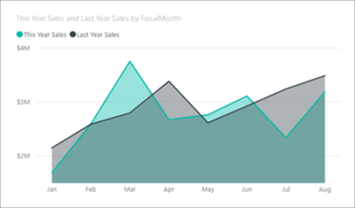
Data Representation
Data Representation Chart in Power BI
Area charts: Basic (Layered) and Stacked
The basic area chart is based on the line chart with the area between the axis and line filled in.
Area charts emphasize the magnitude of change over time, and can be used to draw attention to the total value across a trend.
For example, data that represents profit over time can be plotted in an area chart to emphasize the total profit.
Notes:
https://www.tableau.com/sites/default/files/whitepapers/which_chart_or_graph_is_right_for_youwp_1.pdf
https://docs.microsoft.com/en-us/power-bi/visuals/power-bi-visualization-types-for-reports-and-q-and-a

Slide 67
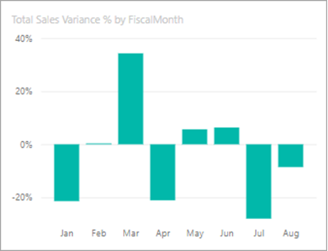
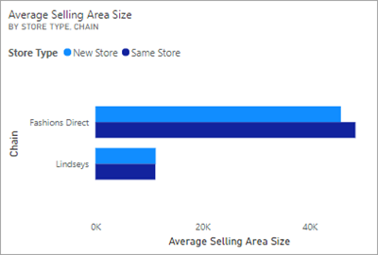
Data Representation
Data Representation Chart in Power BI
Bar and column charts
Bar charts are the standard for looking at a specific value across different categories.
Ultimately, the bar and the column chart can be used either way; however, the column chart is better used in the case of making comparisons while the bar charts are better used in cases where the data to be represented are a lot, and the labels are lengthy.

Slide 68

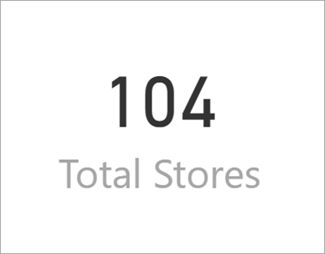
Data Representation
Data Representation Chart in Power BI
Cards: Multi row
Cards: Single number
Single number cards display a single fact, a single data point.
Sometimes a single number is the most important thing you want to track in your Power BI dashboard or report, such as total sales, market share year over year, or total opportunities.

Slide 69
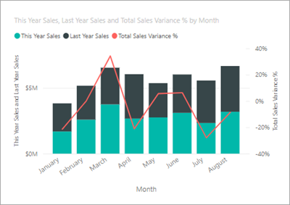
Data Representation
Data Representation Chart in Power BI
Combo charts
A combo chart combines a column chart and a line chart. Combining the two charts into one lets you make a quicker comparison of the data. Combo charts can have one or two Y axes, so be sure to look closely.
Combo charts are a great choice:
When you have a line chart and a column chart with the same X axis.
To compare multiple measures with different value ranges.
To illustrate the correlation between two measures in one visual.
To check whether one measure meets the target which is defined by another measure.
To conserve canvas space.

Slide 70
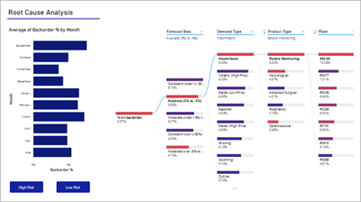
Data Representation
Data Representation Chart in Power BI
Decomposition tree
The decomposition tree visual lets you visualize data across multiple dimensions.
It automatically aggregates data and enables drilling down into your dimensions in any order.
It is also an artificial intelligence (AI) visualization, so you can ask it to find the next dimension to drill down into based on certain criteria.
This makes it a valuable tool for ad hoc exploration and conducting root cause analysis.

Slide 71
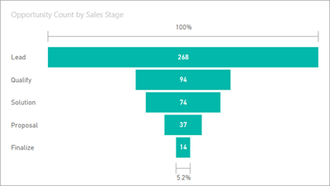
Data Representation
Data Representation Chart in Power BI
Funnel charts
Funnels help visualize a process that has stages, and items flow sequentially from one stage to the next. One example is a sales process that starts with leads and ends with purchase fulfillment.
For example, a sales funnel that tracks customers through stages: Lead > Qualified Lead > Prospect > Contract > Close. At a glance, the shape of the funnel conveys the health of the process you're tracking. Each funnel stage represents a percentage of the total.
So, in most cases, a funnel chart is shaped like a funnel -- with the first stage being the largest, and each subsequent stage smaller than its predecessor. A pear-shaped funnel is also useful -- it can identify a problem in the process. But typically, the first stage, the "intake" stage, is the largest.

Slide 72
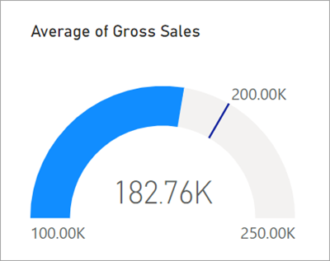
Data Representation
Data Representation Chart in Power BI
Gauge charts
A radial gauge chart has a circular arc and displays a single value that measures progress toward a goal/KPI.
The goal, or target value, is represented by the line (needle). Progress toward that goal is represented by the shading.
And the value that represents that progress is shown in bold inside the arc. All possible values are spread evenly along the arc, from the minimum (left-most value) to the maximum (right-most value).
In the example above, we are a car retailer, tracking our Sales team's average sales per month. Our goal is 140 and represented by the black needle. The minimum possible average sales is 0 and we've set the maximum as 200. The blue shading shows that we're currently averaging approximately 120 sales this month. Luckily, we still have another week to reach our goal.
Radial gauges are a great choice to:
Show progress toward a goal.
Represent a percentile measure, like a KPI.
Show the health of a single measure.
Display information that can be quickly scanned and understood.

Slide 73
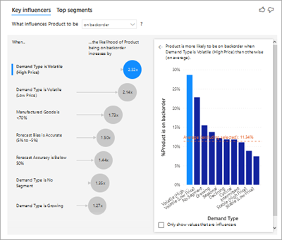
Data Representation
Data Representation Chart in Power BI
Key influencers chart
A key influencer chart displays the major contributors to a selected result or value.
Key influencers are a great choice to help you understand the factors that influence a key metric.
For example, what influences customers to place a second order or why were sales so high last June.

Slide 74
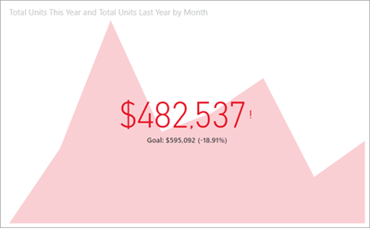
Data Representation
Data Representation Chart in Power BI
KPIs
A Key Performance Indicator (KPI) is a visual cue that communicates the amount of progress made toward a measurable goal.
KPIs are a great choice:
To measure progress (what am I ahead or behind on?).
To measure distance to a goal (how far ahead or behind am I?).
Notes:
https://docs.microsoft.com/en-us/power-bi/visuals/power-bi-visualization-types-for-reports-and-q-and-a

Slide 75
Data Binding
Data binding is the process of associating a set of data, usually a data model or the result set of a query, with a report element.
Data binding is most common with table, chart, and section elements, but can also be used with text-based elements.
It can be done easily through the Designer, in which case the binding information is stored in the report template.
Binding is also possible programmatically, through report scripting and can also be statically embedded into the element.

Slide 76
Data Collection
Data collection is the process of gathering and measuring information on targeted variables in an established system, which then enables one to answer relevant questions and evaluate outcomes.
Data collection is a research component in all study fields, including physical and social sciences, humanities, and business.
Type of Data in Big Data:
Structured Data
Unstructured Data
Semi-Structured Data

Slide 77
Data Collection
Structured Data
Any data that can be processed, accessed and stored as a fixed-format is named structured data.
Throughout some period, ability in software engineering has made more noteworthy progress in creating techniques for working with such sort of data and inferring an incentive out of it.
Notwithstanding, these days, we are anticipating issues when the size of such data develops to an enormous degree, average sizes are being in the fury of various zettabytes.
Structured data in big data is the most straightforward to work with.
Structured data is a types of big data that profoundly coordinated with measurements described by setting parameters.
It’s all your quantitative data:
Address, Debit/credit card numbers, Age, Expenses, Contact, Billing

Slide 78
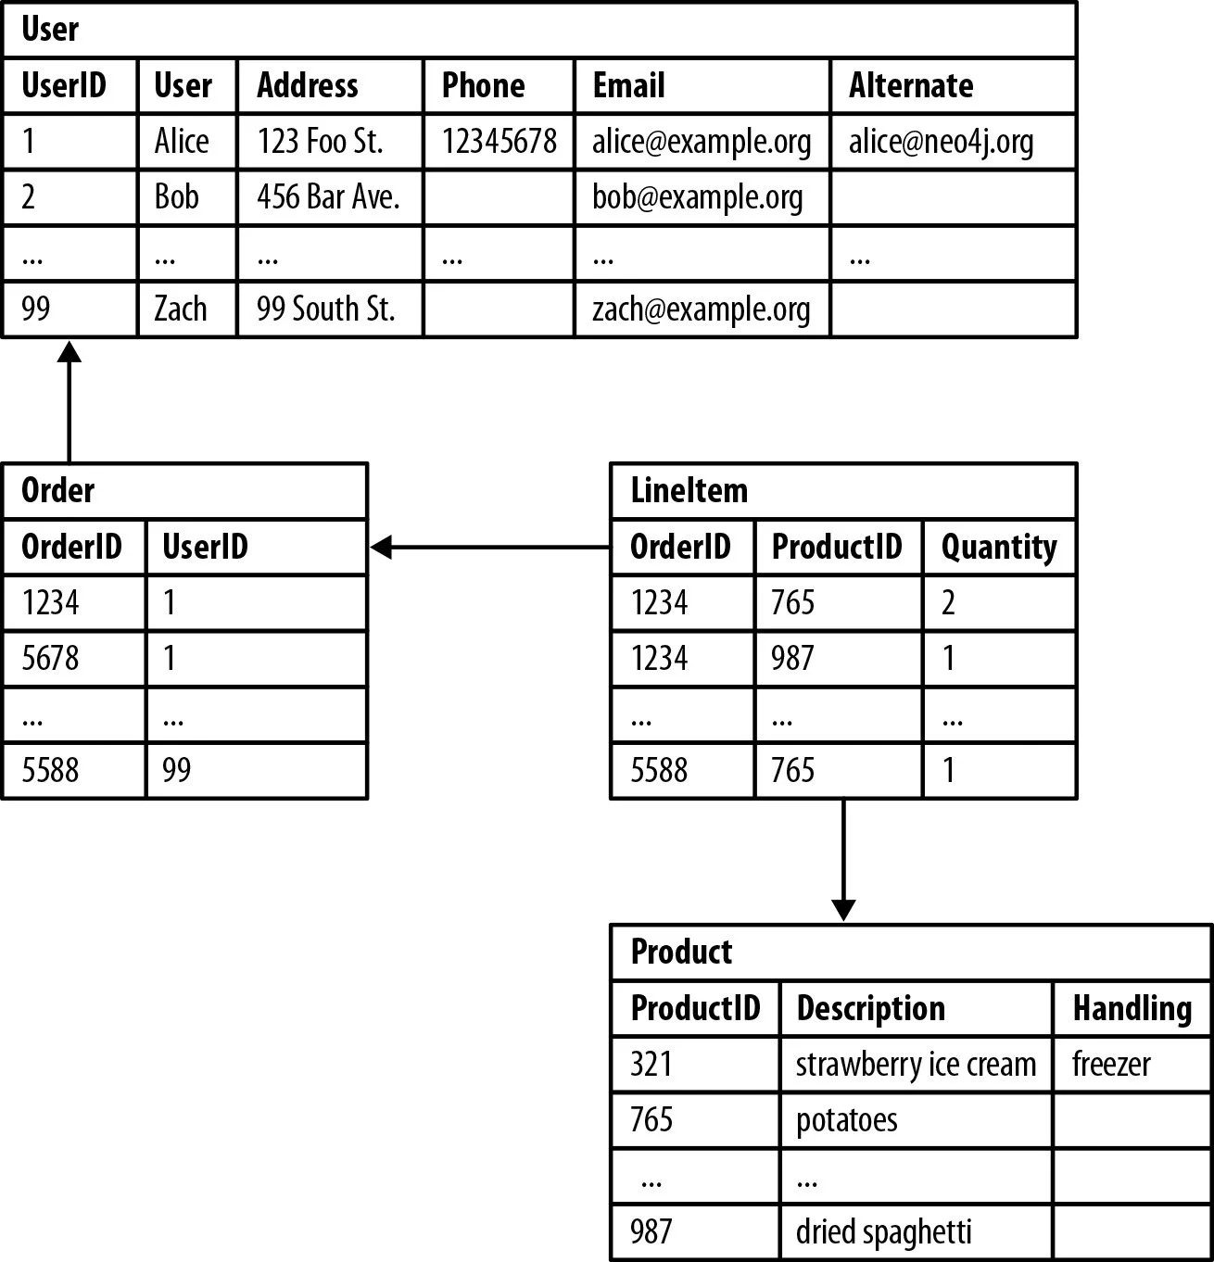
Data Collection
Structured Data
An ‘Employee’ table in a database is a Structured Data Examples.
Employee_ID | Employee_Name | Gender | Department | Salary_In_ Lacs
1865 | Meg Lanning | Female | HR | 6,30,000
2145 | Virat Kohli | Male | Finance | 6,30,000
4500 | Ellyse Perry | Female | HR | 4,00,000
5475 | Alyssa Healy | Female | HR | 4,00,000
6570 | Rohit Sharma | Male | Finance | 5,30,000

Slide 79
Data Collection
Unstructured Data
Unstructured data is information that is not arranged according to a pre-set data model or schema, and therefore cannot be stored in a traditional relational database or RDBMS.
Text and multimedia are two common types of unstructured content.
Many business documents are unstructured, as are email messages, videos, photos, webpages, and audio files.
From 80 to 90 percent of data generated and collected by organizations, is unstructured,, and its volumes are growing rapidly — many times faster than the rate of growth for structured databases.
Unstructured data stores contain a wealth of information that can be used to guide business decisions.
However, unstructured data has historically been very difficult to analyze.
With the help of AI and machine learning, new software tools are emerging that can search through vast quantities of it to uncover beneficial and actionable business intelligence.

Slide 80
Data Collection
Unstructured Data
What are some examples of unstructured data?
Unstructured data can be created by people or generated by machines.
Here are some examples of the human-generated variety:
Email: Email message fields are unstructured and cannot be parsed by traditional analytics tools. That said, email metadata affords it some structure, and explains why email is sometimes considered semi-structured data.
Text files: This category includes word processing documents, spreadsheets, presentations, email, and log files.
Social media and websites: Data from social networks like Twitter, LinkedIn, and Facebook, and websites such as Instagram, photo-sharing sites, and YouTube.
Mobile and communications data: Text messages, phone recordings, collaboration software, Chat, and Instant Messaging.
Media: Digital photos, audio, and video files.

Slide 81
Data Collection
Unstructured Data
Here are some examples of unstructured data generated by machines:
Scientific data: Oil and gas surveys, space exploration, seismic imagery, and atmospheric data.
Digital surveillance: Reconnaissance photos and videos.
Satellite imagery: Weather data, land forms, and military movements.
Notes:
https://www.mongodb.com/unstructured-data
What is structured, semi-structured, and unstructured data?
As we’ve already seen, structured data is organized in ways that make for easy searching. Unstructured data — comprising most other types — exists in formats such as audio, video, and social media postings, and is not easy for conventional tools to search.
The contrasting of one type “versus” the other should not be thought of as a conflict. You simply choose one or the other based on the applications you’re interested in. Relational databases handle structured data, and just about all other kinds of systems can house unstructured data.
Common RDBMS applications using structured data include airline reservation systems, inventory control, sales transactions, and ATM activity. Typical unstructured use cases are media viewing and editing tools, presentation software, and word processing.
There is also a third category called semi-structured data. While not stored in relational databases, this type of information has some organizing properties, making it easier to parse and analyze. Specifically, semi-structured data contains internal tags and markings that allow for grouping and hierarchies.
Email is a common semi-structured data application. While detailed email analysis requires sophisticated tools, its native metadata allows for basic classification and keyword searches. Semi-structured data is only a 5% to10% slice of the total enterprise data pie, but it has some critical use cases. Examples include the XML markup language, the versatile JSON data-interchange format, and databases of the NoSQL or non-relational variety. These last are a good choice for storing information such as text with variable lengths. The most widely-used non-relational database, MongoDB, accommodates semi-structured documents by natively storing them in the JSON format.

Slide 82
Data Collection
Semi-structured data
Semi-structured data is the data which does not conforms to a data model but has some structure.
It lacks a fixed or rigid schema. It is the data that does not reside in a rational database but that have some organizational properties that make it easier to analyze. With some process, we can store them in the relational database.
Characteristics of semi-structured Data:
Data does not conforms to a data model but has some structure.
Data can not be stored in the form of rows and columns as in Databases
Semi-structured data contains tags and elements (Metadata) which is used to group data and describe how the data is stored
Similar entities are grouped together and organised in a hierarchy
Entities in the same group may or may not have the same attributes or properties
Does not contains sufficient metadata which makes automation and management of data difficult
Size and type of the same attributes in a group may differ
Due to lack of a well defined structure, it can not used by computer programs easily
Notes:
What is structured, semi-structured, and unstructured data?
As we’ve already seen, structured data is organized in ways that make for easy searching. Unstructured data — comprising most other types — exists in formats such as audio, video, and social media postings, and is not easy for conventional tools to search.
The contrasting of one type “versus” the other should not be thought of as a conflict. You simply choose one or the other based on the applications you’re interested in. Relational databases handle structured data, and just about all other kinds of systems can house unstructured data.
Common RDBMS applications using structured data include airline reservation systems, inventory control, sales transactions, and ATM activity. Typical unstructured use cases are media viewing and editing tools, presentation software, and word processing.
There is also a third category called semi-structured data. While not stored in relational databases, this type of information has some organizing properties, making it easier to parse and analyze. Specifically, semi-structured data contains internal tags and markings that allow for grouping and hierarchies.
Email is a common semi-structured data application. While detailed email analysis requires sophisticated tools, its native metadata allows for basic classification and keyword searches. Semi-structured data is only a 5% to10% slice of the total enterprise data pie, but it has some critical use cases. Examples include the XML markup language, the versatile JSON data-interchange format, and databases of the NoSQL or non-relational variety. These last are a good choice for storing information such as text with variable lengths. The most widely-used non-relational database, MongoDB, accommodates semi-structured documents by natively storing them in the JSON format.

Slide 83
Data Collection
Semi-structured data
Sources of semi-structured Data:
E-mails
XML and other markup languages
Binary executables
TCP/IP packets
Zipped files
Integration of data from different sources
Web pages
Notes:
What is structured, semi-structured, and unstructured data?
As we’ve already seen, structured data is organized in ways that make for easy searching. Unstructured data — comprising most other types — exists in formats such as audio, video, and social media postings, and is not easy for conventional tools to search.
The contrasting of one type “versus” the other should not be thought of as a conflict. You simply choose one or the other based on the applications you’re interested in. Relational databases handle structured data, and just about all other kinds of systems can house unstructured data.
Common RDBMS applications using structured data include airline reservation systems, inventory control, sales transactions, and ATM activity. Typical unstructured use cases are media viewing and editing tools, presentation software, and word processing.
There is also a third category called semi-structured data. While not stored in relational databases, this type of information has some organizing properties, making it easier to parse and analyze. Specifically, semi-structured data contains internal tags and markings that allow for grouping and hierarchies.
Email is a common semi-structured data application. While detailed email analysis requires sophisticated tools, its native metadata allows for basic classification and keyword searches. Semi-structured data is only a 5% to10% slice of the total enterprise data pie, but it has some critical use cases. Examples include the XML markup language, the versatile JSON data-interchange format, and databases of the NoSQL or non-relational variety. These last are a good choice for storing information such as text with variable lengths. The most widely-used non-relational database, MongoDB, accommodates semi-structured documents by natively storing them in the JSON format.

Slide 84
MS Excel Function
List of Functions
Logical:
And
If
IFNA
OR
NOT
Date and Time:
DATE
DATEIF
HOUR
WEEKDAY
Lookup and reference
ADDRESS
COLUMN
FORMULATEXT
HLOOKUP
INDEX
LOOKUP
Text
CONCAT
CONCATENATE
DOLLAR
EXACT
LOWER
VALUE
DATA ANALYSIS FUNCTIONS
LEN
COUNTA
DAYS/NETWORKDAYS
SUMIFS
AVERAGEIFS
FIND/SEARCH
VLOOKUP
IFERROR
COUNTIF

Slide 85
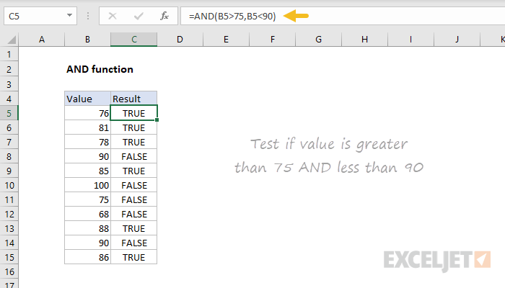
MS Excel Function
Logical: AND
The Excel AND function is a logical function used to require more than one condition at the same time.
AND returns either TRUE or FALSE. To test if a number in A1 is greater than zero and less than 10, use =AND(A1>0,A1<10).
The AND function can be used as the logical test inside the IF function to avoid extra nested IFs, and can be combined with the OR function.

Slide 86
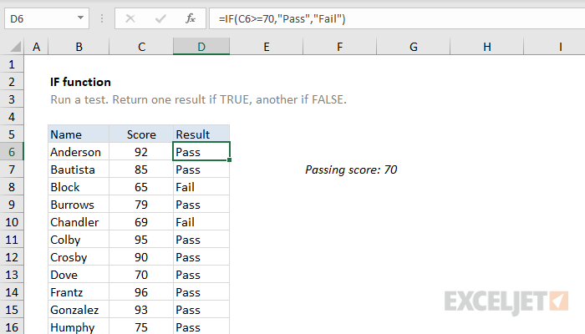
MS Excel Function
Logical: IF
The IF function runs a logical test and returns one value for a TRUE result, and another for a FALSE result.
For example, to "pass" scores above 70: =IF(A1>70,"Pass","Fail"). More than one condition can be tested by nesting IF functions.
The IF function can be combined with logical functions like AND and OR to extend the logical test.

Slide 87
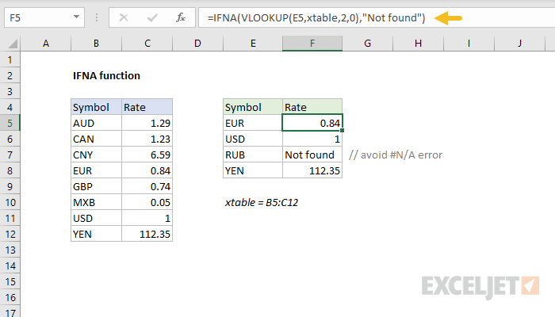
MS Excel Function
Logical: IFNA
The Excel IFNA function is a simple way to trap and handle #N/A errors specifically without catching other errors.
The IFNA function returns a custom result when a formula generates the #N/A error, and a normal result when no error is detected.

Slide 88
MS Excel Function
Logical: OR
The OR function is a logical function to test multiple conditions at the same time.
OR returns either TRUE or FALSE. For example, to test A1 for either "x" or "y", use =OR(A1="x",A1="y").
The OR function can be used as the logical test inside the IF function to avoid extra nested IFs, and can be combined with the AND function.

Slide 89
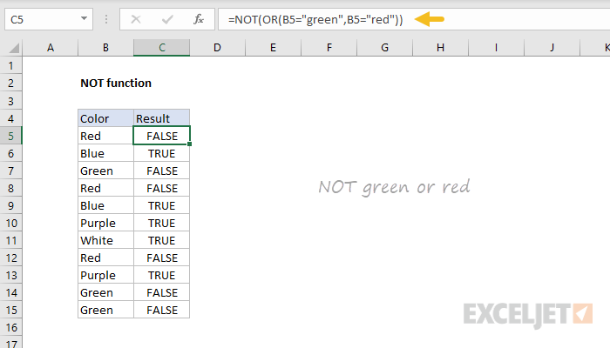
MS Excel Function
Logical: NOT
The Excel NOT function returns the opposite of a given logical or Boolean value. When given TRUE, NOT returns FALSE.
When given FALSE, NOT returns TRUE. Use the NOT function to reverse a logical value.

Slide 90
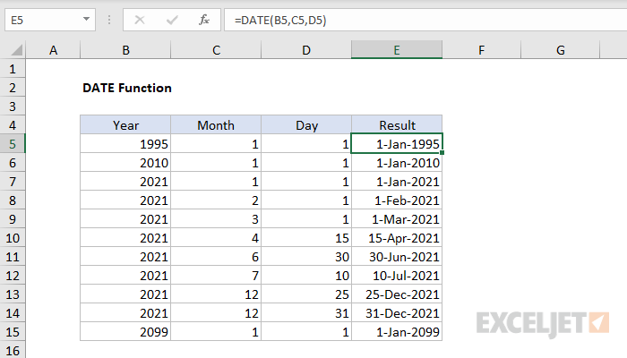
MS Excel Function
Date and Time: DATE
The Excel DATE function creates a valid date from individual year, month, and day components.
The DATE function is useful for assembling dates that need to change dynamically based on other values in a worksheet.

Slide 91
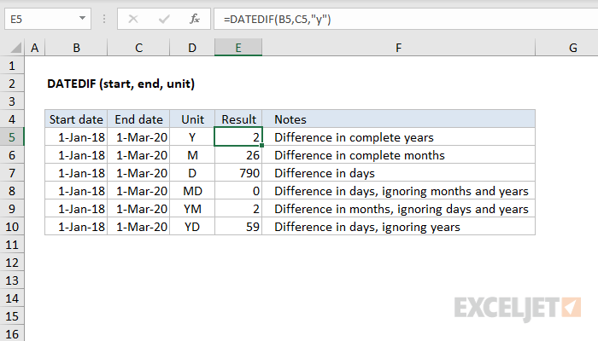
MS Excel Function
Date and Time: DATEIF
The Excel DATEDIF function returns the difference between two date values in years, months, or days. The DATEDIF (Date + Dif) function is a "compatibility" function that comes from Lotus 1-2-3. For reasons unknown, it is only documented in Excel 2000, but you can use it in your formulas in all Excel versions since that time.
Note: Excel won't help you fill out the arguments for DATEDIF like other functions, but it will work when configured correctly.

Slide 92
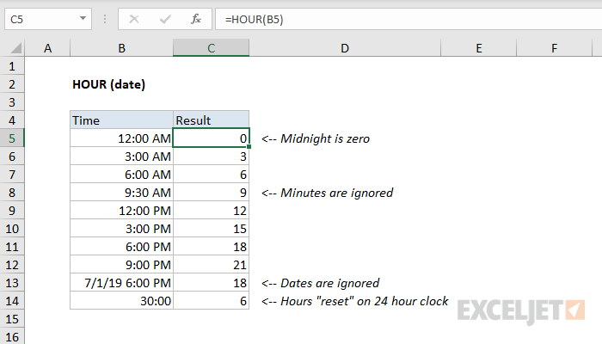
MS Excel Function
Date and Time: HOUR
The Excel HOUR function returns the hour component of a time as a number between 0-23.
For example, with a time of 9:30 AM, HOUR will return 9. You can use the HOUR function to extract the hour into a cell, or feed the result into another formula, like the TIME function.

Slide 93
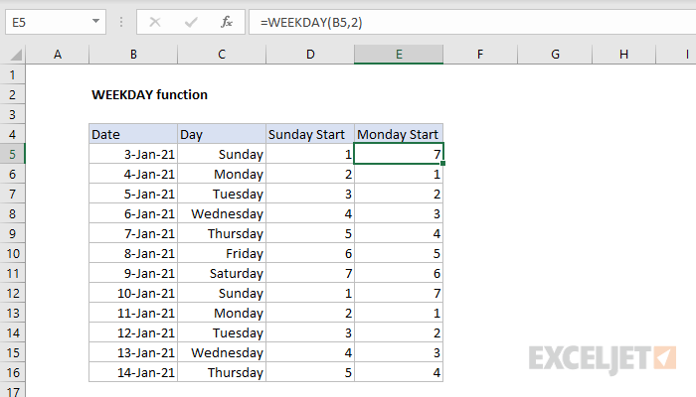
MS Excel Function
Date and Time: WEEKDAY
The Excel WEEKDAY function takes a date and returns a number between 1-7 representing the day of week.
By default, WEEKDAY returns 1 for Sunday and 7 for Saturday, but this is configurable.
You can use the WEEKDAY function inside other formulas to check the day of week.

Slide 94
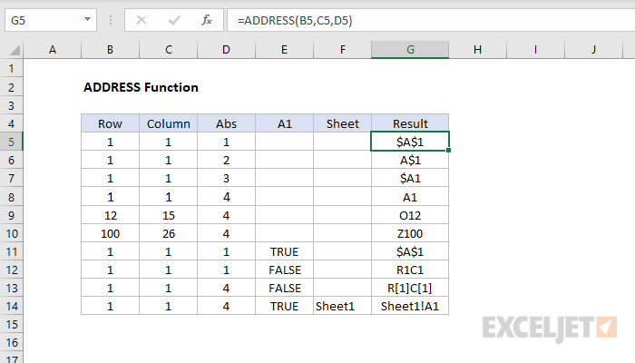
MS Excel Function
Lookup and Reference: ADDRESS
The Excel ADDRESS function returns the address for a cell based on a given row and column number.
For example, =ADDRESS(1,1) returns $A$1. ADDRESS can return an address in relative, mixed, or absolute format, and can be used to construct a cell reference inside a formula.

Slide 95
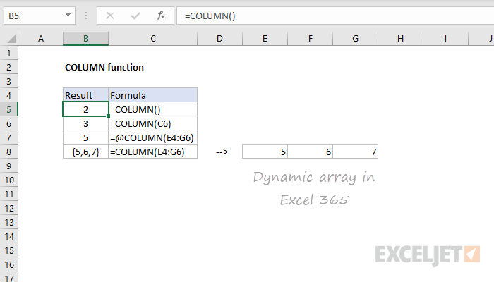
MS Excel Function
Lookup and Reference: COLUMN
The Excel COLUMN function returns the column number for a reference.
For example, COLUMN(C5) returns 3, since C is the third column in the spreadsheet.
When no reference is provided, COLUMN returns the column number of the cell which contains the formula.

Slide 96
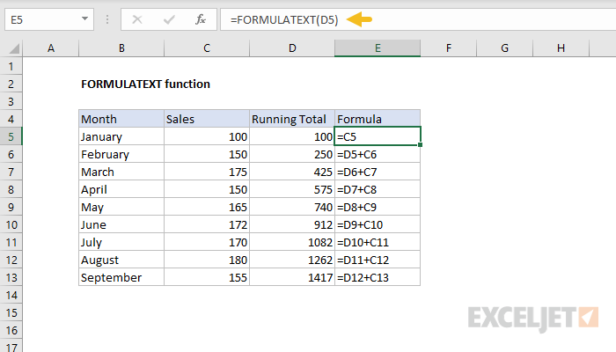
MS Excel Function
Lookup and Reference: FORMULATEXT
The Excel FORMULATEXT function returns a formula as a text string from a given reference.
You can use FORMULATEXT to extract the formula as text from a cell.
If you use FORMULATEXT on a cell that doesn't contain a formula, it returns #N/A.

Slide 97
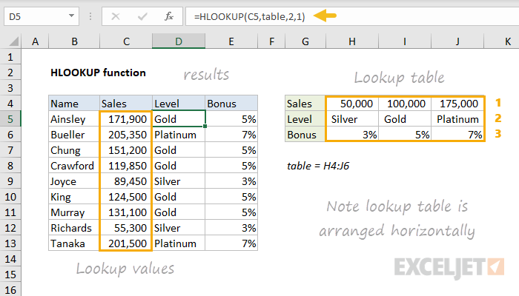
MS Excel Function
Lookup and Reference: HLOOKUP
The Excel HLOOKUP function finds and retrieve a value from data in a horizontal table.
The "H" in HLOOKUP stands for "horizontal", and lookup values must appear in the first row of the table, moving horizontally to the right.
HLOOKUP supports approximate and exact matching, and wildcards (* ?) for finding partial matches.

Slide 98
MS Excel Function
Lookup and Reference: HLOOKUP
The Excel INDEX function returns the value at a given location in a range or array. You can use INDEX to retrieve individual values, or entire rows and columns.
The MATCH function is often used together with INDEX to provide row and column numbers.

Slide 99
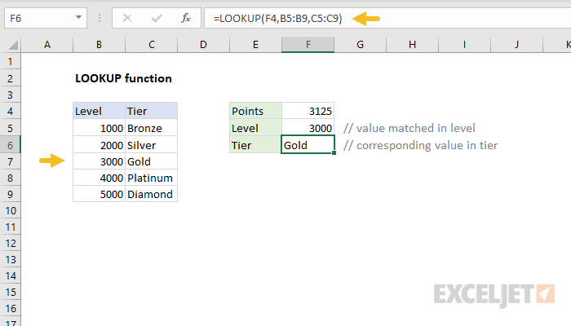
MS Excel Function
Lookup and Reference: HLOOKUP
The Excel LOOKUP function performs an approximate match lookup in a one-column or one-row range, and returns the corresponding value from another one-column or one-row range.
LOOKUP's default behavior makes it useful for solving certain problems in Excel.

Slide 100
MS Excel Function
Lookup and Reference: HLOOKUP
The Excel LOOKUP function performs an approximate match lookup in a one-column or one-row range, and returns the corresponding value from another one-column or one-row range.
LOOKUP's default behavior makes it useful for solving certain problems in Excel.

Slide 101
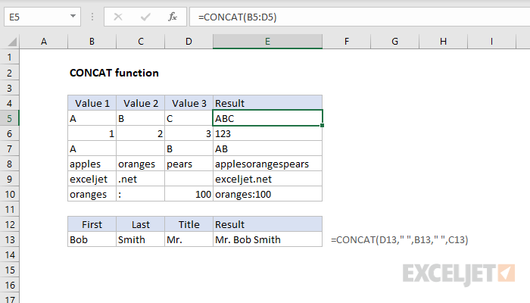
MS Excel Function
Text: CONCAT
The Excel CONCAT function concatenates (joins) values supplied as references or constants.
Unlike the CONCATENATE function (which CONCAT replaces), CONCAT will accept a range of cells to join, in addition to individual cell references.

Slide 102
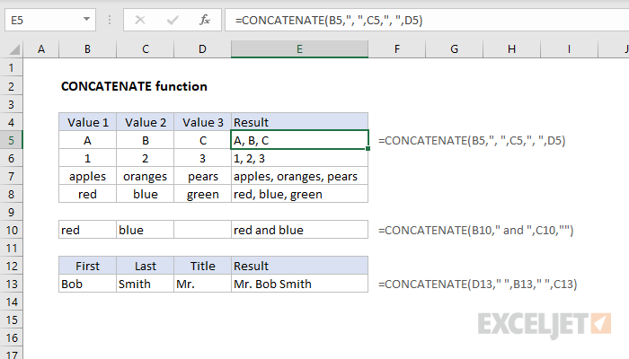
MS Excel Function
Text: CONCATENATE
The Excel CONCATENATE function concatenates (joins) join up to 30 values together and returns the result as text.
In Excel 2019 and later, the CONCAT and TEXTJOIN functions are better, more flexible alternatives.

Slide 103
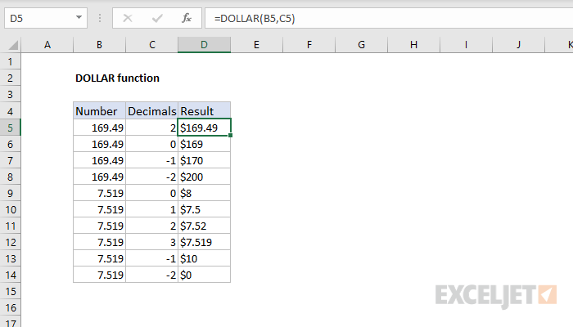
MS Excel Function
Text: DOLLAR
The Excel DOLLAR function converts a number to text using the Currency number format.
The TEXT function can do the same thing, and is much more versatile.

Slide 104
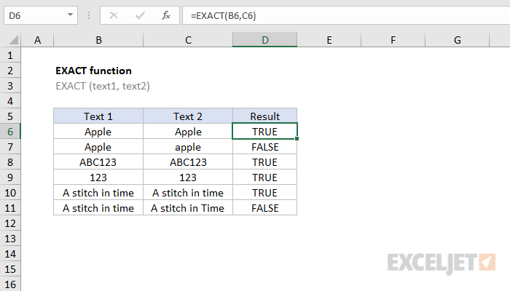
MS Excel Function
Text: EXACT
The Excel EXACT function compares two text strings, taking into account upper and lower case characters, and returns TRUE if they are the same, and FALSE if not. EXACT is case-sensitive.

Slide 105
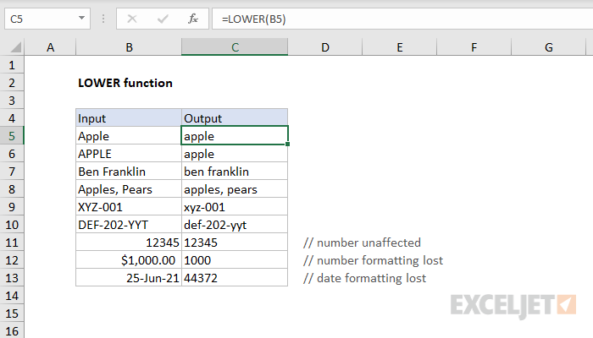
MS Excel Function
Text: LOWER
The Excel LOWER function converts a text string to all lowercase letters. Numbers, punctuation, and spaces are not affected.

Slide 106
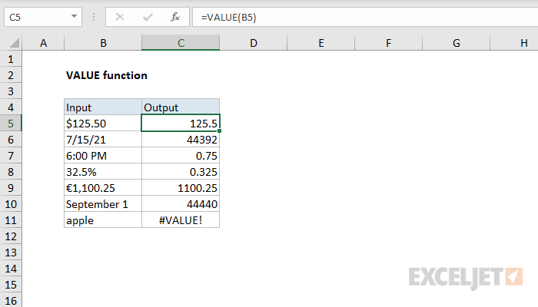
MS Excel Function
Text: LOWER
The Excel VALUE function converts text that appears in a recognized format (i.e. a number, date, or time format) into a numeric value.
Normally, the VALUE function is not needed in Excel, because Excel automatically converts text to numeric values.

Slide 107
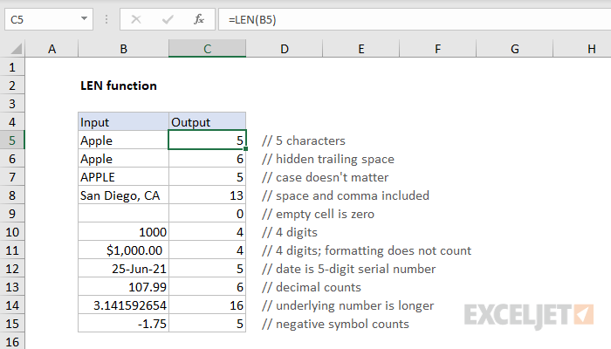
MS Excel Function
DATA ANALYSIS FUNCTIONS: LEN
The Excel LEN function returns the length of a given text string as the number of characters.
LEN will also count characters in numbers, but number formatting is not included.

Slide 108
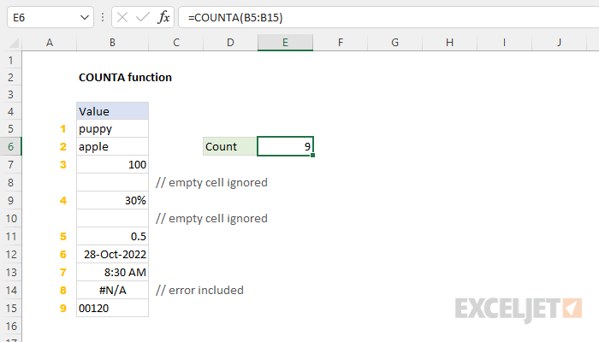
MS Excel Function
DATA ANALYSIS FUNCTIONS: COUNTA
The Excel COUNTA function returns the count of cells that contain numbers, text, logical values, error values, and empty text ("").
COUNTA does not count empty cells.

Slide 109
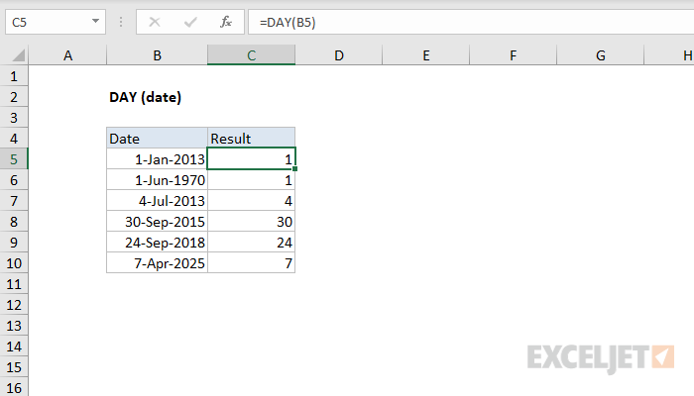
MS Excel Function
DATA ANALYSIS FUNCTIONS: DAY
The Excel DAY function returns the day of the month as a number between 1 to 31 from a given date. You can use the DAY function to extract a day number from a date into a cell.
You can also use the DAY function to extract and feed a day value into another function, like the DATE function.

Slide 110
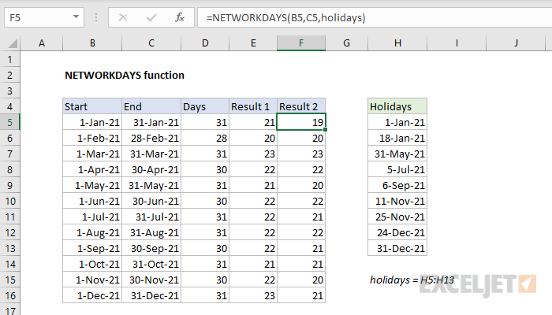
MS Excel Function
DATA ANALYSIS FUNCTIONS: NETWORKDAYS
The Excel NETWORKDAYS function calculates the number of working days between two dates.
NETWORKDAYS automatically excludes weekends (Saturday and Sunday) and can optionally exclude a list of holidays supplied as dates.

Slide 111

MS Excel Function
DATA ANALYSIS FUNCTIONS: AVERAGEIFS
The Excel AVERAGEIFS function calculates the average of numbers in a range that meet one or more criteria.
The criteria used for AVERAGEIFS can include logical operators (>,<,<>,=) and wildcards (*,?) for partial matching.

Slide 112

MS Excel Function
DATA ANALYSIS FUNCTIONS: FIND
The Excel FIND function returns the position (as a number) of one text string inside another.
When the text is not found, FIND returns a #VALUE error.

Slide 113

MS Excel Function
DATA ANALYSIS FUNCTIONS: SEARCH
The Excel SEARCH function returns the location of one text string inside another.
SEARCH returns the position of the first character of find_text inside within_text. Unlike FIND, SEARCH allows wildcards, and is not case-sensitive.

Slide 114

MS Excel Function
DATA ANALYSIS FUNCTIONS: VLOOKUP
VLOOKUP is an Excel function to look up data in a table organized vertically. VLOOKUP supports approximate and exact matching, and wildcards (* ?) for partial matches.
Lookup values must appear in the first column of the table passed into VLOOKUP.

Slide 115

MS Excel Function
DATA ANALYSIS FUNCTIONS: VLOOKUP
The Excel IFERROR function returns a custom result when a formula generates an error, and a standard result when no error is detected.
IFERROR is an elegant way to trap and manage errors without using more complicated nested IF statements.

Slide 116

MS Excel Function
DATA ANALYSIS FUNCTIONS: VLOOKUP
COUNTIF is an Excel function to count cells in a range that meet a single condition. COUNTIF can be used to count cells that contain dates, numbers, and text.
The criteria used in COUNTIF supports logical operators (>,<,<>,=) and wildcards (*,?) for partial matching.

Slide 117
MS Excel FORMULAS
One of the most powerful features in Excel is the ability to calculate numerical information using formulas. Just like a calculator, Excel can add, subtract, multiply, and divide. In this lesson, we'll show you how to use cell references to create simple formulas.

Slide 118

MS Excel FORMULAS
Mathematical operators
Excel uses standard operators for formulas, such as a plus sign for addition (+), a minus sign for subtraction (-), an asterisk for multiplication (*), a forward slash for division (/), and a caret (^) for exponents.
All formulas in Excel must begin with an equals sign (=). This is because the cell contains, or is equal to, the formula and the value it calculates.

Slide 119


MS Excel FORMULAS
Understanding cell references
While you can create simple formulas in Excel manually (for example, =2+2 or =5*5), most of the time you will use cell addresses to create a formula. This is known as making a cell reference. Using cell references will ensure that your formulas are always accurate because you can change the value of referenced cells without having to rewrite the formula.
By combining a mathematical operator with cell references, you can create a variety of simple formulas in Excel. Formulas can also include a combination of cell references and numbers, as in the examples below:

Slide 120

MS Excel FORMULAS
Modifying values with cell references
The true advantage of cell references is that they allow you to update data in your worksheet without having to rewrite formulas. In the example below, we've modified the value of cell B1 from $1,200 to $1,800. The formula in B3 will automatically recalculate and display the new value in cell B3.
Excel will not always tell you if your formula contains an error, so it's up to you to check all of your formulas.

Slide 121

MS Excel FORMULAS
To create a formula using the point-and-click method:
Rather than typing cell addresses manually, you can point and click on the cells you want to include in your formula. This method can save a lot of time and effort when creating formulas. In our example below, we'll create a formula to calculate the cost of ordering several boxes of plastic silverware.
Select the cell that will contain the formula. In our example, we'll select cell D3.
Type the equals sign (=).

Slide 122


MS Excel FORMULAS
To create a formula using the point-and-click method:
Select the cell you want to reference first in the formula: cell B3 in our example. The cell address will appear in the formula, and a dashed blue line will appear around the referenced cell.
Type the mathematical operator you want to use. In our example, we'll type the multiplication sign (*).
Select the cell you want to reference second in the formula: cell C3 in our example. The cell address will appear in the formula, and a dashed red line will appear around the referenced cell.
Press Enter on your keyboard. The formula will be calculated, and the value will be displayed in the cell.

Slide 123

MS Excel FORMULAS
To create a formula using the point-and-click method:
Formulas can also be copied to adjacent cells with the fill handle, which can save a lot of time and effort if you need to perform the same calculation multiple times in a worksheet.

Slide 124
MS Excel CHARTS
It can be difficult to interpret Excel workbooks that contain a lot of data. Charts allow you to illustrate your workbook data graphically, which makes it easy to visualize comparisons and trends.

Slide 125

MS Excel CHARTS
Understanding charts
Excel has several different types of charts, allowing you to choose the one that best fits your data. In order to use charts effectively, you'll need to understand how different charts are used.

Slide 126

MS Excel CHARTS
Understanding charts

Slide 127

MS Excel CHARTS
Understanding charts

Slide 128

MS Excel CHARTS
Understanding charts

Slide 129

MS Excel CHARTS
Understanding charts

Slide 130

MS Excel CHARTS
Understanding charts

Slide 131

MS Excel CHARTS
Understanding charts

Slide 132

MS Excel CHARTS
Understanding charts
In addition to chart types, you'll need to understand how to read a chart. Charts contain several different elements, or parts, that can help you interpret the data.

Slide 133

MS Excel CHARTS
To insert a chart:
Select the cells you want to chart, including the column titles and row labels. These cells will be the source data for the chart. In our example, we'll select cells A1:F6.

Slide 134

MS Excel CHARTS
To insert a chart:
From the Insert tab, click the desired Chart command. In our example, we'll select Column.

Slide 135

MS Excel CHARTS
To insert a chart:
Choose the desired chart type from the drop-down menu.

Slide 136

MS Excel CHARTS
To insert a chart:
The Selected chart will be inserted into the worksheet.

Slide 137

MS Excel CHARTS
Chart and layout style
After inserting a chart, there are several things you may want to change about the way your data is displayed. It's easy to edit a chart's layout and style from the Design tab.
Excel allows you to add chart elements—such as chart titles, legends, and data labels—to make your chart easier to read. To add a chart element, click the Add Chart Element command on the Design tab, then choose the desired element from the drop-down menu.

Slide 138

MS Excel CHARTS
Chart and layout style
To edit a chart element, like a chart title, simply double-click the placeholder and begin typing.

Slide 139

MS Excel CHARTS
Chart and layout style
If you don't want to add chart elements individually, you can use one of Excel's predefined layouts. Simply click the Quick Layout command, then choose the desired layout from the drop-down menu.

Slide 140

MS Excel CHARTS
Chart and layout style
Excel also includes several chart styles, which allow you to quickly modify the look and feel of your chart. To change the chart style, select the desired style from the Chart styles group. You can also click the drop-down arrow on the right to see more styles.

Slide 141

MS Excel CHARTS
Chart and layout style
You can also use the chart formatting shortcut buttons to quickly add chart elements, change the chart style, and filter the chart data.

Slide 142
MS Excel PIVOT TABLES
When you have a lot of data, it can sometimes be difficult to analyze all of the information in your worksheet. PivotTables can help make your worksheets more manageable by summarizing your data and allowing you to manipulate it in different ways.

Slide 143

MS Excel PIVOT TABLES
Using PivotTables to answer questions
Consider the example below. Let's say we wanted to answer the question What is the amount sold by each salesperson? Answering it could be time consuming and difficult; each salesperson appears on multiple rows, and we would need to total all of their different orders individually. We could use the Subtotal command to help find the total for each salesperson, but we would still have a lot of data to work with.

Slide 144

MS Excel PIVOT TABLES
Using PivotTables to answer questions
Fortunately, a PivotTable can instantly calculate and summarize the data in a way that will make it much easier to read. When we're done, the PivotTable will look something like this:

Slide 145

MS Excel PIVOT TABLES
Using PivotTables to answer questions
Once you've created a PivotTable, you can use it to answer different questions by rearranging—or pivoting—the data. For example, let's say we wanted to answer What is the total amount sold in each month? We could modify our PivotTable to look like this:

Slide 146

MS Excel PIVOT TABLES
To create a PivotTable:
Select the table or cells (including column headers) you want to include in your PivotTable.

Slide 147

MS Excel PIVOT TABLES
To create a PivotTable:
From the Insert tab, click the PivotTable command.

Slide 148

MS Excel PIVOT TABLES
To create a PivotTable:
The Create PivotTable dialog box will appear. Choose your settings, then click OK. In our example, we'll use Table1 as our source data and place the PivotTable on a new worksheet.

Slide 149

MS Excel PIVOT TABLES
To create a PivotTable:
A blank PivotTable and Field List will appear on a new worksheet.

Slide 150

MS Excel PIVOT TABLES
To create a PivotTable:
Once you create a PivotTable, you'll need to decide which fields to add. Each field is simply a column header from the source data. In the PivotTable Field List, check the box for each field you want to add. In our example, we want to know the total amount sold by each salesperson, so we'll check the Salesperson and Order Amount fields.

Slide 151

MS Excel PIVOT TABLES
To create a PivotTable:
The selected fields will be added to one of the four areas below. In our example, the Salesperson field has been added to the Rows area, while Order Amount has been added to Values. Alternatively, you can drag and drop fields directly into the desired area.

Slide 152

MS Excel PIVOT TABLES
To create a PivotTable:
The PivotTable will calculate and summarize the selected fields. In our example, the PivotTable shows the amount sold by each salesperson.

Slide 153

MS Excel PIVOT TABLES
To create a PivotTable:
Just like with normal spreadsheets, you can sort the data in a PivotTable using the Sort & Filter command on the Home tab. You can also apply any type of number formatting you want. For example, you may want to change the number format to Currency. However, be aware that some types of formatting may disappear when you modify the PivotTable.
If you change any of the data in your source worksheet, the PivotTable will not update automatically. To manually update it, select the PivotTable and then go to Analyze

Slide 154
MS Excel PIVOT TABLES
Pivoting data
One of the best things about PivotTables is that they can quickly pivot—or reorganize—your data, allowing you to examine your worksheet in several ways. Pivoting data can help you answer different questions and even experiment with your data to discover new trends and patterns.

Slide 155

MS Excel PIVOT TABLES
To add columns:
So far, our PivotTable has only shown one column of data at a time. In order to show multiple columns, you'll need to add a field to the Columns area.
Drag a field from the Field List into the Columns area. In our example, we'll use the Month field.

Slide 156

MS Excel PIVOT TABLES
To add columns:
The PivotTable will include multiple columns. In our example, there is now a column for each person's monthly sales, in addition to the grand total.

Slide 157

MS Excel PIVOT TABLES
To change a row or column:
Changing a row or column can give you a completely different perspective on your data. All you have to do is remove the field in question, then replace it with another.
Drag the field you want to remove out of its current area. You can also uncheck the appropriate box in the Field List. In this example, we've removed the Month and Salesperson fields.

Slide 158

MS Excel PIVOT TABLES
To change a row or column:
Drag a new field into the desired area. In our example, we'll place the Region field under Rows.

Slide 159

MS Excel PIVOT TABLES
To change a row or column:
The PivotTable will adjust—or pivot—to show the new data. In our example, it now shows the amount sold by each region.

Slide 160
MS Excel ADVANCED PIVOT TABLES
As you learned in our previous lesson, Intro to PivotTables, PivotTables can be used to summarize and analyze almost any type of data. To help you manipulate your PivotTable—and gain even more insight into your data—Excel offers three additional tools: filters, slicers, and PivotCharts.

Slide 161
MS Excel ADVANCED PIVOT TABLES
Filters
Sometimes you may want focus on a certain section of your data. Filters can be used to narrow down the data in your PivotTable, so you can view only the information you need.

Slide 162

MS Excel ADVANCED PIVOT TABLES
Filters: To add a filter
In the example below, we'll filter out certain salespeople to determine how their individual sales are impacting each region.
Drag a field from the Field List to the Filters area. In this example, we'll use the Salesperson field.

Slide 163

MS Excel ADVANCED PIVOT TABLES
Filters: To add a filter
The filter will appear above the PivotTable. Click the drop-down arrow, then check the box next to Select Multiple Items.

Slide 164

MS Excel ADVANCED PIVOT TABLES
Filters: To add a filter
Uncheck the box next to any item you don't want to include in the PivotTable. In our example, we'll uncheck the boxes for a few salespeople, then click OK.

Slide 165

MS Excel ADVANCED PIVOT TABLES
Filters: To add a filter
The PivotTable will adjust to reflect the changes.

Slide 166
MS Excel ADVANCED PIVOT TABLES
Slicers
Slicers make filtering data in PivotTables even easier. Slicers are basically just filters but are easier and faster to use, allowing you to instantly pivot your data. If you frequently filter your PivotTables, you may want to consider using slicers instead of filters.

Slide 167

MS Excel ADVANCED PIVOT TABLES
Slicers: To add a slicer
Select any cell in the PivotTable.
From the Analyze tab, click the Insert Slicer command.

Slide 168

MS Excel ADVANCED PIVOT TABLES
Slicers: To add a slicer
A dialog box will appear. Check the box next to the desired field. In our example, we'll select Salesperson, then click OK.

Slide 169

MS Excel ADVANCED PIVOT TABLES
Slicers: To add a slicer
The slicer will appear next to the PivotTable. Each selected item will be highlighted in blue. In the example below, the slicer contains all eight salespeople, but only five of them are currently selected.

Slide 170

MS Excel ADVANCED PIVOT TABLES
Slicers: To add a slicer
Just like filters, only selected items are used in the PivotTable. When you select or deselect an item, the PivotTable will instantly reflect the change. Try selecting different items to see how they affect the PivotTable. Press and hold the Ctrl key on your keyboard to select multiple items at once.

Slide 171
MS Excel ADVANCED PIVOT TABLES
PivotCharts
PivotCharts are like regular charts, except they display data from a PivotTable. Just like regular charts, you'll be able to select a chart type, layout, and style that will best represent the data.

Slide 172

MS Excel ADVANCED PIVOT TABLES
PivotCharts: To create a PivotCharT
In the example below, our PivotTable is showing a portion of each region's sales figures. We'll use a PivotChart so we can see the information more clearly.
Select any cell in your PivotTable.
From the Insert tab, click the PivotChart command.

Slide 173

MS Excel ADVANCED PIVOT TABLES
PivotCharts: To create a PivotCharT
The Insert Chart dialog box will appear. Select the desired chart type and layout, then click OK.

Slide 174

MS Excel ADVANCED PIVOT TABLES
PivotCharts: To create a PivotCharT
The PivotChart will appear.

Slide 175

MS Excel ADVANCED PIVOT TABLES
PivotCharts: To create a PivotCharT
Try using filters or slicers to narrow down the data in your PivotChart. To view different subsets of information, change the columns or rows in your PivotTable. In the example below, we've changed the PivotTable to view the monthly sales for each salesperson.

Slide 176
MS Excel Data Analysis ToolPak
The Analysis ToolPak is an Excel add-in program that provides data analysis tools for financial, statistical and engineering data analysis.
The Analysis ToolPak is an add-in for Microsoft Excel that comes with Microsoft Excel. An add-in is simply a hidden workbook that adds commands or features to Excel.

Slide 177

MS Excel Data Analysis ToolPak
How to Install DAT
On the File tab, click Options.
Under Add-ins, select Analysis ToolPak and click on the Go button.

Slide 178

MS Excel Data Analysis ToolPak
How to Install DAT
3. Check Analysis ToolPak and click on OK.

Slide 179

MS Excel Data Analysis ToolPak
How to Install DAT
4. On the Data tab, in the Analysis group, you can now click on Data Analysis.

Slide 180

MS Excel Data Analysis ToolPak
How to Install DAT
The following dialog box below appears.

Slide 181
MS Excel Data Analysis ToolPak
How to Install DAT
The following dialog box below appears.

Slide 182
MS Excel Data Analysis ToolPak
Descriptive statistics
Descriptive statistics are one of the fundamental “must knows” with any set of data.
It gives us a general idea of trends in the data like getting to know The mean, mode, median for the range or Variance and standard deviation, Skewness, Count, maximum and minimum.
Descriptive statistics is useful because it allows you to take a large amount of data and summarize it.
For example, let’s say you had data on the incomes of one million people.
No one is going to want to read a million pieces of data; if they did, they wouldn’t be able to glean any useful information from it.
On the other hand, if you summarize it, it becomes useful: an average wage, or a median income, is much easier to understand than reams of data.

Slide 183
MS Excel Data Analysis ToolPak
Descriptive statistics Features
Statistic | Description
Mean | Shows the arithmetic mean of the sample data.
Standard Error | Shows the standard error of the data set
Median | Shows the middle value in the data set
Mode | Shows the most common value in the data set.
Standard Deviation | Shows the sample standard deviation measure for the dataset
Sample Variance | Shows the sample variance for the data set
Kurtosis | Shows the kurtosis of the distribution.
Skewness | Shows the skewness of the data set’s distribution.

Slide 184
MS Excel Data Analysis ToolPak
Descriptive statistics Features
Statistic | Description
Range | Shows the difference between the largest and smallest values in the data set.
Minimum | Shows the smallest value in the data set.
Maximum | Shows the largest value in the data set.
Sum | Adds all the values in the data set together to calculate the sum
Count | Counts the number of values in a data set.
Largest(X) | Shows the largest X value in the data set.
Smallest(X) | Shows the smallest X value in the data set.
Confidence Level(X) Percentage | Shows the confidence level at a given percentage for the dataset values.

Slide 185

MS Excel Data Analysis ToolPak
How to Calculate Excel Descriptive Statistics: Steps
You can use the Analysis Toolpak add-in to generate descriptive statistics. For example, you may have the scores of 14 participants for a test.

Slide 186
MS Excel Data Analysis ToolPak
How to Calculate Excel Descriptive Statistics: Steps
To generate descriptive statistics for these scores, execute the following steps.
1. On the Data tab, in the Analysis group, click Data Analysis.

Slide 187



2. Select Descriptive Statistics and click OK.
3. Select the range A2:A15 as the Input Range.
4. Select cell C1 as the Output Range.
5. Make sure Summary statistics is checked.
6. Click OK.
Result:
MS Excel Data Analysis ToolPak
How to Calculate Excel Descriptive Statistics: Steps
To generate descriptive statistics for these scores, execute the following steps.
1. On the Data tab, in the Analysis group, click Data Analysis.

Slide 188
MS Excel Data Analysis ToolPak
How to Calculate Excel Descriptive Statistics: Steps
2. Select Descriptive Statistics and click OK.

Slide 189
MS Excel Data Analysis ToolPak
How to Calculate Excel Descriptive Statistics: Steps
3. Select the range A2:A15 as the Input Range.

Slide 190
MS Excel Data Analysis ToolPak
How to Calculate Excel Descriptive Statistics: Steps
4. Select cell C1 as the Output Range.
5. Make sure Summary statistics is checked.

Slide 191
MS Excel Data Analysis ToolPak
correlation
The CORREL and PEARSON worksheet functions both calculate the correlation coefficient between two measurement variables when measurements on each variable are observed for each of N subjects. (Any missing observation for any subject causes that subject to be ignored in the analysis.) The Correlation analysis tool is particularly useful when there are more than two measurement variables for each of N subjects. It provides an output table, a correlation matrix, that shows the value of CORREL (or PEARSON) applied to each possible pair of measurement variables.
The correlation coefficient, like the covariance, is a measure of the extent to which two measurement variables "vary together." Unlike the covariance, the correlation coefficient is scaled so that its value is independent of the units in which the two measurement variables are expressed. (For example, if the two measurement variables are weight and height, the value of the correlation coefficient is unchanged if weight is converted from pounds to kilograms.) The value of any correlation coefficient must be between -1 and +1 inclusive.
You can use the correlation analysis tool to examine each pair of measurement variables to determine whether the two measurement variables tend to move together — that is, whether large values of one variable tend to be associated with large values of the other (positive correlation), whether small values of one variable tend to be associated with large values of the other (negative correlation), or whether values of both variables tend to be unrelated (correlation near 0 (zero)).

Slide 192
Data analytics Life Cycle

Slide 193
Agenda
Discovery,
Data preparation
Model planning
Model building implementation
Quality assurance
Documentation
Management approval
Installation
Acceptance and operation

Slide 194

WHAT IS DATA ANALYTICS LIFECYCLE?
Data Analytics Lifecycle defines the roadmap of how data is generated, collected, processed, used, and analyzed to achieve business goals.

Slide 195
WHAT IS DATA ANALYTICS LIFECYCLE?
In today’s digital-first world, data is of immense importance.
It undergoes various stages throughout its life, during its creation, testing, processing, consumption, and reuse.
Data Analytics Lifecycle maps out these stages for professionals working on data analytics projects.
These phases are arranged in a circular structure that forms a Data Analytics Lifecycle.
Each step has its significance and characteristics.

Slide 196
IMPORTANCE OF DATA ANALYTICS LIFECYCLE
Data Analytics Lifecycle defines the roadmap of how data is generated, collected, processed, used, and analyzed to achieve business goals.
It offers a systematic way to manage data for converting it into information that can be used to fulfill organizational and project goals.
The process provides the direction and methods to extract information from the data and proceed in the right direction to accomplish business goals.
Data professionals use the lifecycle’s circular form to proceed with data analytics in either forward or backward direction.
Based on the newly received insights, they can decide whether to proceed with their existing research or scrap it and redo the complete analysis.
The Data Analytics lifecycle guides them throughout this process.

Slide 197
DATA ANALYTICS LIFECYCLE PHASES
There’s no defined structure of the phases in the life cycle of Data Analytics, and thus, there may not be uniformity in these steps.
There can be some data professionals that follow additional steps, while there may be some who skip some stages altogether or work on different phases simultaneously.
Let us discuss the various phases of the data analytics life cycle.
This guide talks about the phases that are fundamental to each data analytics process.
Hence, they are more likely to be present in most data analytics projects’ lifecycle.
The Data Analytics lifecycle primarily consists of 6 phases.

Slide 198
Phase 1: Data Discovery and Formation
This phase is all about defining the data’s purpose and how to achieve it by the end of the data analytics lifecycle.
The stage consists of identifying critical objectives a business is trying to discover by mapping out the data.
During this process, the team learns about the business domain and checks whether the business unit or organization has worked on similar projects to refer to any learnings.
In this phase, the team also evaluates technology, people, data, and time.
For example, while dealing with a small dataset, the team can use Excel. However, heftier tasks demand more rigid tools for data preparation and exploration.
In such scenarios, the team will need to use Python, R, Tableau Desktop or Tableau Prep, and other data cleaning tools.
This phase’s critical activities include framing the business problem, formulating initial hypotheses to test, and beginning data learning.

Slide 199

Phase 2: Data Preparation and Processing
In this phase, the experts’ focus shifts from business requirements to information requirements.
One of the essential aspects of this phase is ensuring data availability for processing.
The stage encompasses the collection, processing, and cleansing of the accumulated data.

Slide 200
Phase 2: Data Preparation and Processing
During this phase’s initial stage, the team gathers valuable information and proceeds with the business ecosystem’s lifecycle.
Various data collection methods are used for this purpose, such as
o Data Entry – Collecting recent data using manual data entry techniques or digital systems within the organization
o Data Acquisition – Gathering data from external sources
o Signal Reception – Capturing data from digital devices, including the Internet of Things and control systems.

Slide 201
Phase 3: Design a Model
This phase needs the availability of an analytic sandbox for the team to work with data and perform analytics throughout the project duration.
The team can load data in several ways.
o Extract, Transform, Load (ETL) – It transforms the data based on a set of business rules before loading it into the sandbox.
o Extract, Load, Transform (ELT) – It loads the data into the sandbox and then transforms it based on a set of business rules.
o Extract, Transform, Load, Transform (ETLT) – It’s the combination of ETL and ELT and has two transformation levels.

Slide 202
Phase 3: Design a Model
The team identifies variables for categorizing data, identifies and amends data errors. Data errors can be anything, including missing data, illogical values, duplicates, and spelling errors.
For example, the team imputes the average data score for categories for missing values. It enables more efficient data processing without skewing the data.
After cleaning the data, the team determines the techniques, methods, and workflow for building a model in the next phase.
The team explores the data, identifies relations between data points to select the key variables, and eventually devises a suitable model.

Slide 203
Phase 4: Model Building
In this phase, the team develops testing, training, and production datasets.
Further, the team builds and executes models meticulously as planned during the model planning phase.
They test data and try to find out answers to the given objectives.
They use various statistical modeling methods such as regression techniques, decision trees, random forest modeling, and neural networks and perform a trial run to determine whether it corresponds to the datasets.

Slide 204
Phase 4: Model Building
In this phase, the team develops testing, training, and production datasets.
Further, the team builds and executes models meticulously as planned during the model planning phase.
They test data and try to find out answers to the given objectives.
They use various statistical modeling methods such as regression techniques, decision trees, random forest modeling, and neural networks and perform a trial run to determine whether it corresponds to the datasets.
This step of data analytics architecture comprises developing data sets for testing, training, and production purposes. The data analytics experts meticulously build and operate the model that they had designed in the previous step. They rely on tools and several techniques like decision trees, regression techniques (logistic regression), and neural networks for building and executing the model. The experts also perform a trial run of the model to observe if the model corresponds to the datasets.

Slide 205
Phase 5: Result Communication and Publication
This phase aims to determine whether the project results are a success or failure and start collaborating with significant stakeholders.
The team identifies the vital findings of their analysis, measures the associated business value, and creates a summarized narrative to convey the stakeholders’ results.
Remember the goal you had set for your business in phase 1?
Now is the time to check if those criteria are met by the tests you have run in the previous phase.
The communication step starts with a collaboration with major stakeholders to determine if the project results are a success or failure.
The project team is required to identify the key findings of the analysis, measure the business value associated with the result, and produce a narrative to summarise and convey the results to the stakeholders.

Slide 206
Phase 6: Measuring of Effectiveness
In this final phase, the team presents an in-depth report with coding, briefing, key findings, and technical documents and papers to the stakeholders.
Besides this, the data is moved to a live environment and monitored to measure the analysis’s effectiveness.
If the findings are in line with the objective, the results and reports are finalized.
On the other hand, if they deviate from the set intent, the team moves backward in the lifecycle to any previous phase to change the input and get a different outcome.

Slide 207
DATA ANALYTICS LIFECYCLE EXAMPLE
Consider an example of a retail store chain that wants to optimize its products’ prices for boosting its revenue. The store chain has thousands of products over hundreds of outlets, making it a highly complex scenario. Once you identify the store chain’s objective, you find the data you need, prepare it, and go through the Data Analytics lifecycle process.
You observe different types of customers, such as ordinary customers and customers like contractors who buy in bulk. According to you, treating various types of customers differently can give you the solution. However, you don’t have enough information about it and need to discuss this with the client team.
In this case, you need to get the definition, find data, and conduct the hypothesis testing to check whether various customer types impact the model results and get the right output. Once you are convinced with the model results, you can deploy the model, integrate it into the business, and you are all set to deploy the prices you think are the most optimal across the outlets of the store.

